Slide 1
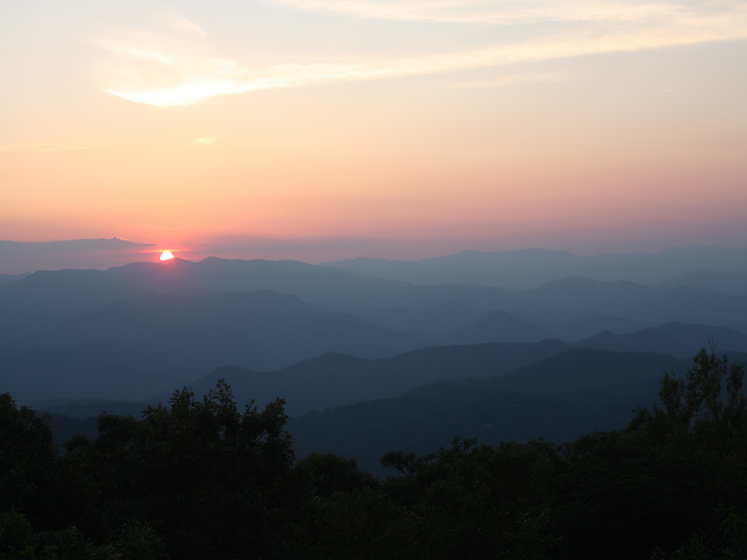
The Mountain Retreat & Learning Center
Highlands, North Carolina

Slide 2
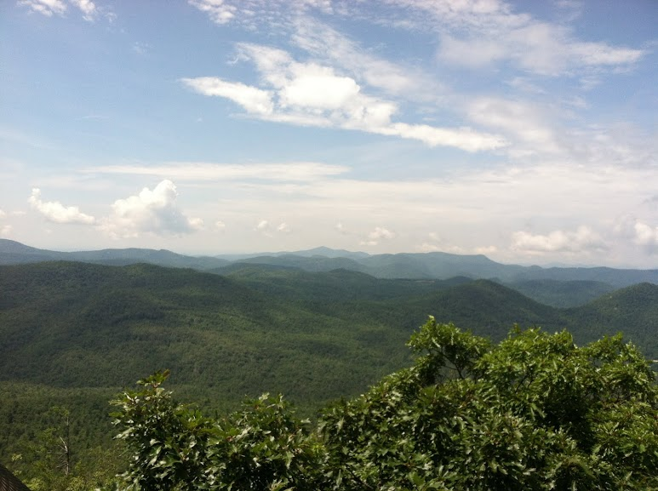
About
Founded by Unitarian Universalists in 1979, The Mountain Retreat & Learning Center is a nonprofit program center, summer youth camp and a retreat for individuals and groups where people can grow and renew themselves.

Slide 3
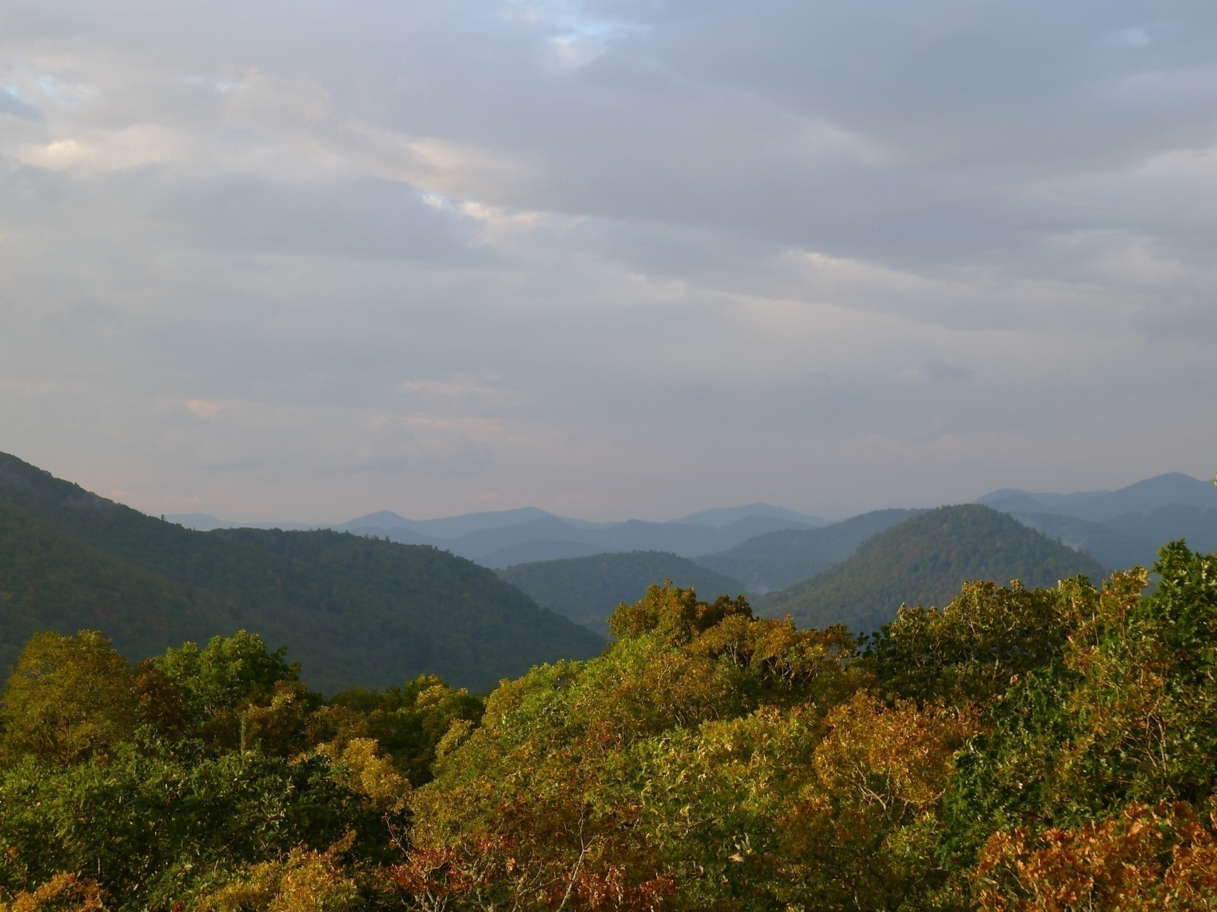
Mission
Vision
The Mountain enriches lives, fosters an appreciation of the natural world, honors the interconnectedness of all things, and inspires people to build inclusive, meaningful, sustainable communities throughout their lives.
An exemplary retreat, camp & learning center that celebrates Unitarian Universalist principles, inspires people of all ages, transforms lives, and builds a more compassionate
world.

Slide 4
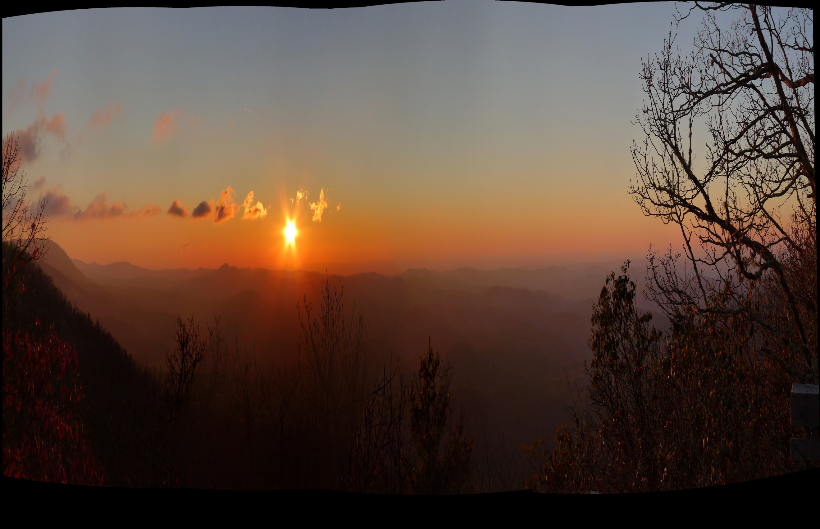
Core Values
Based on the Principles of Unitarian Universalism
The Inherent Worth and Dignity of Every Individual
Justice, Equity and Compassion in Human Relations
Acceptance of One Another and Encouragement to Spiritual Growth
A Free and Responsible Search for Truth and Meaning
The Right of Conscience and the Use of Democratic Process
The Goal of World Community with Peace, Liberty and Justice for All
Respect for the Interdependent Web of All Existence of which we are a Part

Slide 5
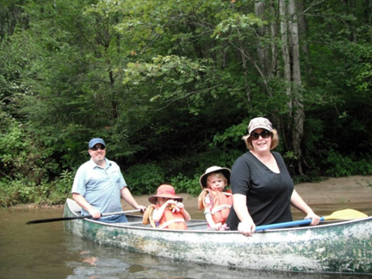
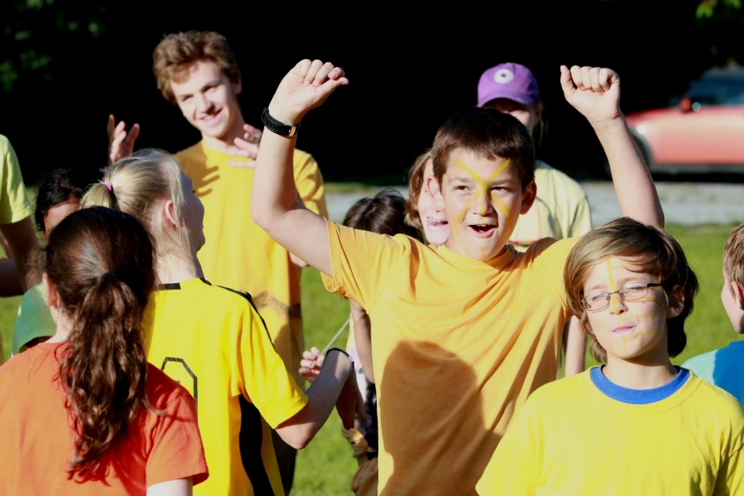
Mountain Programs
Summer MountainCamps for children and youth, from beginner camp to counselors in training!
Family Camp in July
Youth CONs
Southern UU Fall Institute
Thanksgiving Weekend
Easter Work Weekend
Homecoming Weekend
Music Week 2017
And more!

Slide 6
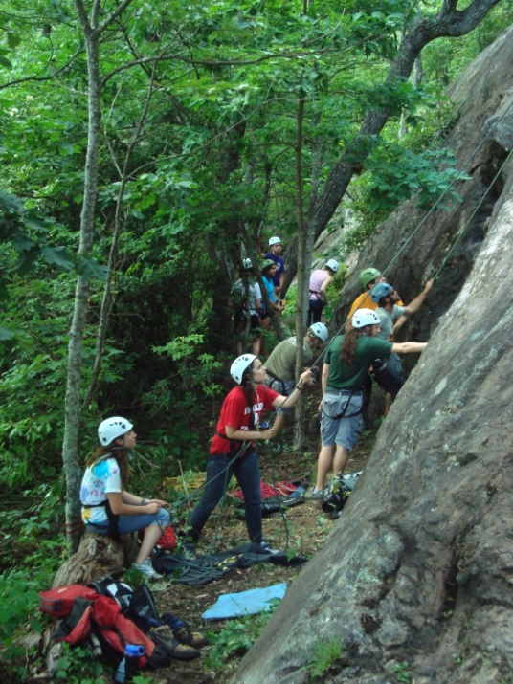
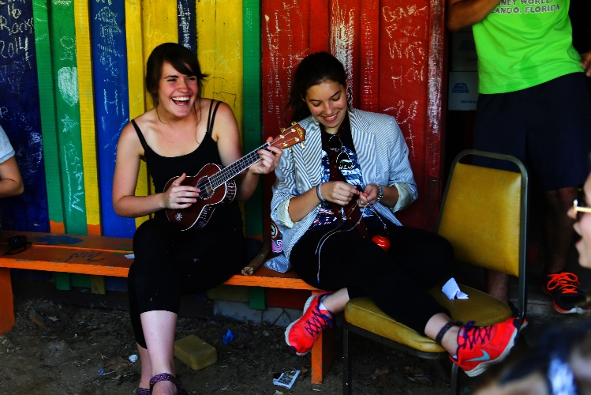
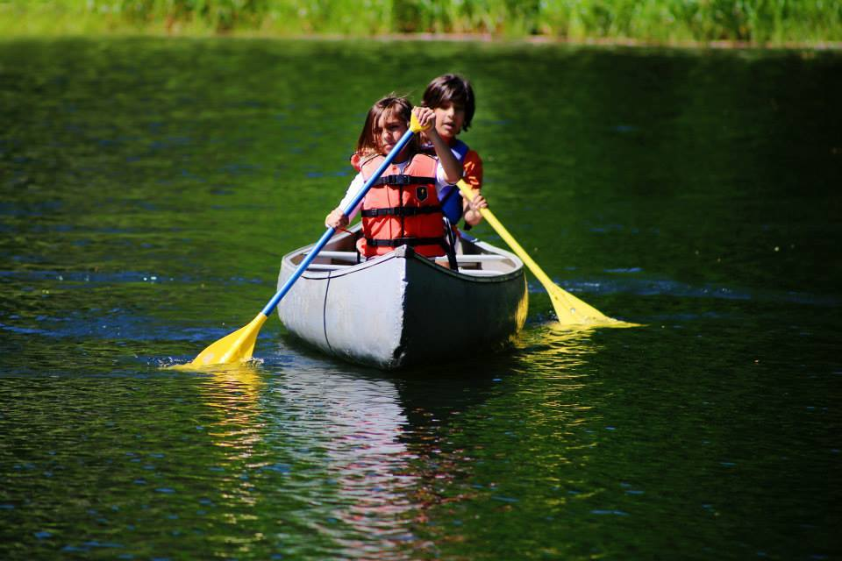
MountainCamps
Beginner Camp (ages 6-8)
Elementary Camp (ages 9-11)
Intermediate Camp (ages 12-14)
Sr. High Camp (ages 15-17)
Explorers (ages 12-14)
Outdoor Skills & Adventure (ages 15-17)
ASCENDER (ages 16-17)
Counselors In Training (ages 17-18)

Slide 7
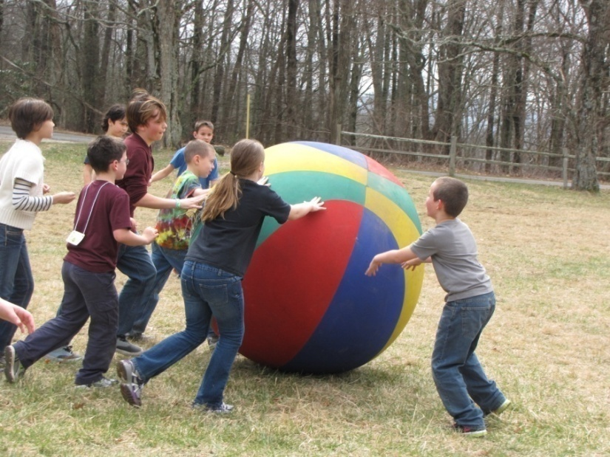
Youth CONferences
Youth gather from congregations for a weekend program filled
with a variety of workshops and activities.
Small groups meet to get to know one another and build
community
Opportunities for fun, reflection and deeper sharing, and free time
Supervision: Volunteering adult advisors, volunteering Peer Advocate
Leaders (PALs), volunteering PAL Mentors, and Mountain Staff

Slide 8
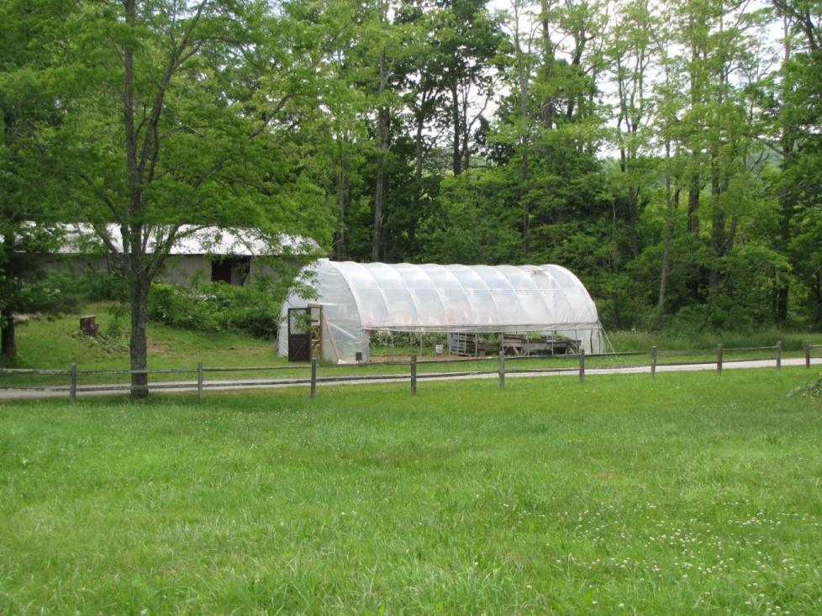
Many Hands Peace Farm
Many Hands Peace Farm raises vegetables and eggs to supplement The Mountain kitchen in their Farm to Table program and provides educational opportunities.
Notes:
People are the heart of The Mountain. People of all ages love The Mountain. They love and care for one another. Many travel from all over the Southern Region and beyond to experience this special place.

Slide 9
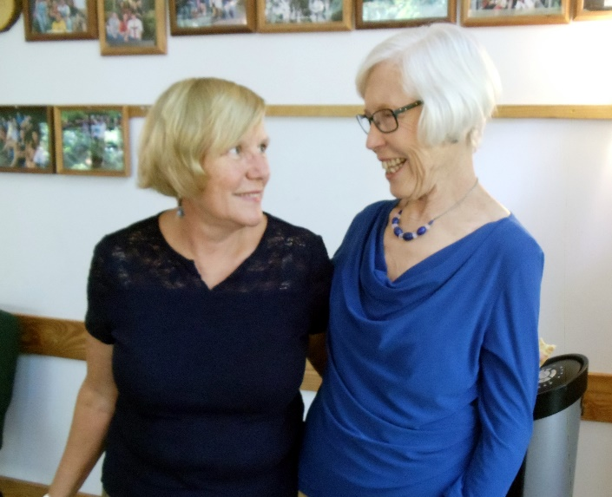
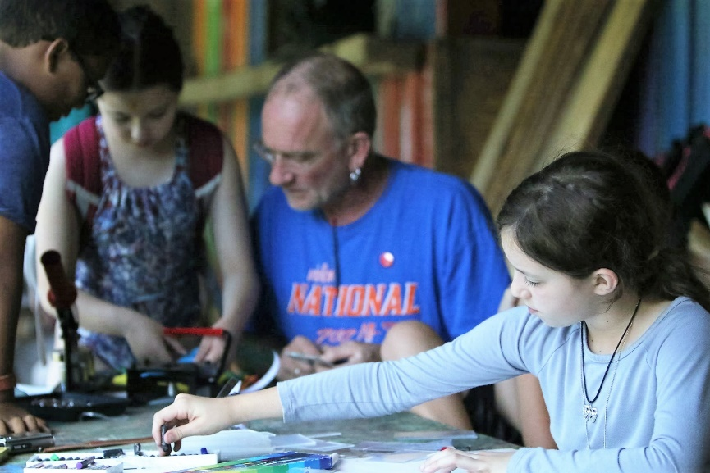
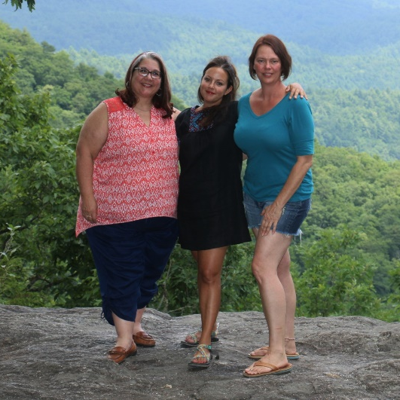
Mountain Community
People are the heart of our Mountain Community!
Notes:
People are the heart of The Mountain. People of all ages love The Mountain. They love and care for one another. Many travel from all over the Southern Region and beyond to experience this special place.

Slide 10
Mountain Volunteers
Interested in volunteering at The Mountain?
Contact us: gsoffice@themountainrlc.org
Notes:
Volunteering is a wonderful way to actively support The Mountain and use your skills to help staff to enhance our facilities and improve the guest experience onsite. Some volunteers assist with buildings and grounds projects, others with housekeeping and kitchen tasks, and still others help with programs, hospitality, and office tasks.

Slide 11
A network of individuals who love and value The Mountain and work to connect UU congregations with The Mountain Retreat & Learning Center.
Share information about Mountain activities, programs, and opportunities with their congregations, promoting active participation and support of The Mountain.

Slide 12
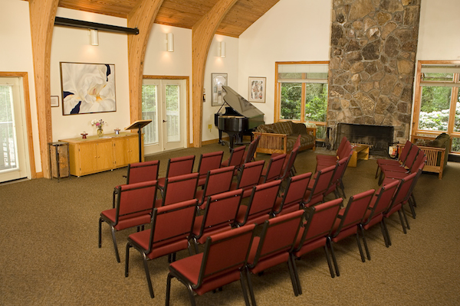
Retreats
The Mountain is a great location for retreats, with the beauty of its mountaintop vista and more than a dozen indoor and outdoor meeting spaces, comfortable overnight accommodations and meals. Our staff is here to help with the planning of….
Personal Retreats
Congregation Retreats
Board Retreats
Group Retreats

Slide 13
Supporting The Mountain
The Mountain Retreat & Learning Center benefits greatly from the generosity of its members and donors. If you appreciate The Mountain, its mission and programs, and would like it to flourish for generations to come, we invite you to make a donation to our Annual Fund or Endowment Fund today.
Go to www.themountainrlc.org to make an online donation today—
THANK YOU for your support!

Slide 14
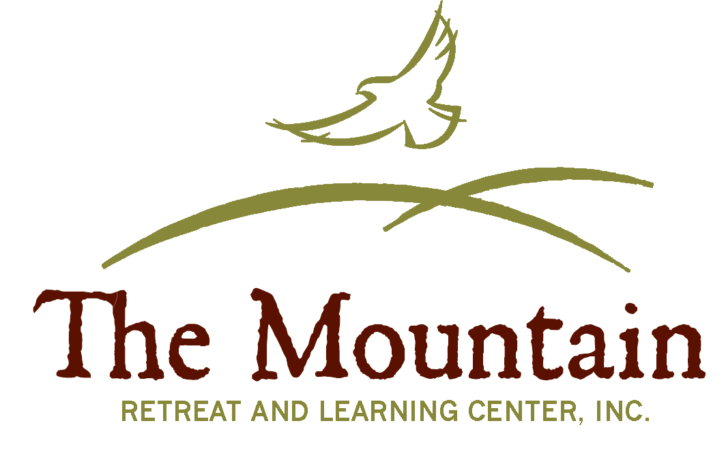
www.themountainrlc.org
Contact us to plan your next visit: (828) 526-5838 or gsoffice@themountainrlc.org

