Slide 1
The Steps That Lead us to Buy This Property
Mid 1970’s, the Southeast UU Summer Institute (SUUSI) was being held at Radford University in Radford, VA.
SUUSI core staff discussion in 1976 suggested that the SUUSI week was just not enough for our kids and what was needed was a summer UU Youth Camp in the Southeast in addition to SUUSI.
SUUSI Board decided to invest in this effort - Committee to explore this concept. Quickly decided should not think only about youth – but also adults and families. Later the goal was expanded to include YEAR-ROUND operations.
Major Market Research study to every 10th UU in the Southeast. Also requested input from the 106 congregations in the three Southeast Districts.
Completed research study showed overwhelming support for the effort and agreement that a facility should be in the mountains of Northeast GA or Western NC.
Decision made to search for an existing facility so that all of this could happen more quickly. The Highlands location met all of the criteria that were hoped for.
Notes:
1 – The Evolution of The Mountain – 1920’s – Today
How long has The Mtn been here – Millions of years… smile
But as a camp – since the 1920’s and it’s a rich history -- get to that in a few minutes
First, though, is the background of how Unitarian Universalists ended up here in very early 1979
Starting in the mid-1970’s, the Southeast UU Summer Institute was being held at Radford University in Radford, VA. Until 2016 it was either there or a few miles away at Virginia Tech University in Blacksburg. But starting in 2016, SUUSI moved to Western Carolina University in Cullowhee, NC a move that was first attempted in 1975 INSTEAD of going to Radford, but Western Carolina wasn’t ready for a conference of that size nor had available dates when it needed to be held. It is hoped SUUSI will be there a long time. If it can it will facilitate more connections between SUUSI and The Mountain.
But back to 1976 when a discussion one evening among SUUSI core staff led to the conclusion that SUUSI was so important for our children as they made key connections with other UU kids. One person then said that SUUSI week was just not enough and what was needed was a summer UU Youth Camp in the Southeast in addition to SUUSI.
That spark grew into a big blaze that led to the SUUSI Board deciding they would invest in this effort and they established a Camp & Conference Center Committee to explore this whole concept – the Conference Center piece being added as people realized we should not think only about youth – but also adults and families. Later the goal was expanded to include YEAR-ROUND operations if at all possible.
SUUSI provided funding to make this all work and a key element was a major market research study of every 15th UU in the then 106 Southeast congregations plus a separate effort to request input from congregational leadership in those congregations in the Southeast. Information learned included where their youth went to camps, if retreats were held by congregations and adult workshops that their people attended. Then the emphasis shifted to where to locate a camp and conference center and whether people would be inclined to attend programming there and support such an effort financially.
When that research study was completed there was overwhelming support for the effort and agreement that a facility should be in the mountains of Northeast GA or Western NC.
The Committee made a decision to search for an existing facility so that all of this could happen more quickly. There were only three camps available – one in North Central GA was not looked at as the travel access was not as desirable but one in Bat Cave, NC and the Highlands facility were visited with conclusion that it met all of the criteria that were hoped for.

Slide 2
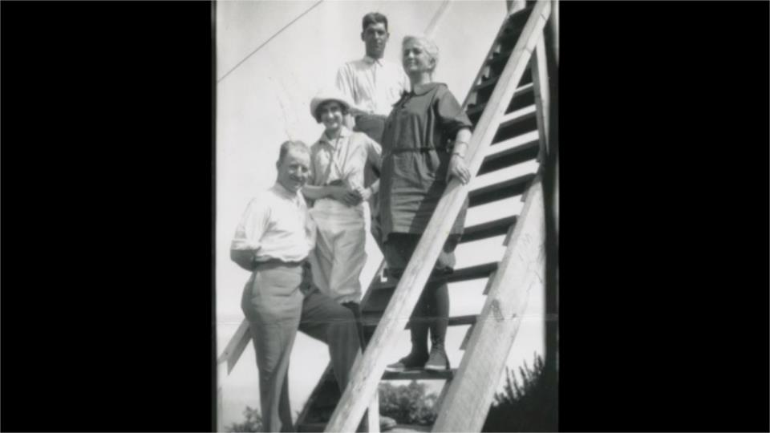
FIRST CAMP ON THIS PROPERTY
Camp Parrydise for Girls -- 1920’s to 50’s
Named for the Parry Family from Atlanta.
The girls, most from Atlanta, would take a train to Dillard, GA, load their luggage onto an ox cart and walked along side it for the 11 mile trek to the camp. About 20-30 girls attended at a time.
Notes:
3 – Camp Parrydise -- 1920’s to 50’s (THE FIRST CAMP HERE)
Pictured here on the steps to the then tower are Maude & Judge Parry and two others. The girls camp so named utilizing their last name. The girls, many from Atlanta, would take a train to Dillard, GA and then load their luggage onto an ox cart, while they walked along side to make the trek to the camp. It looks like there weren’t more than about 20-30 girls in camp at one time. (the walking business was learned in 2018 from a 90 year old former camper.

Slide 3
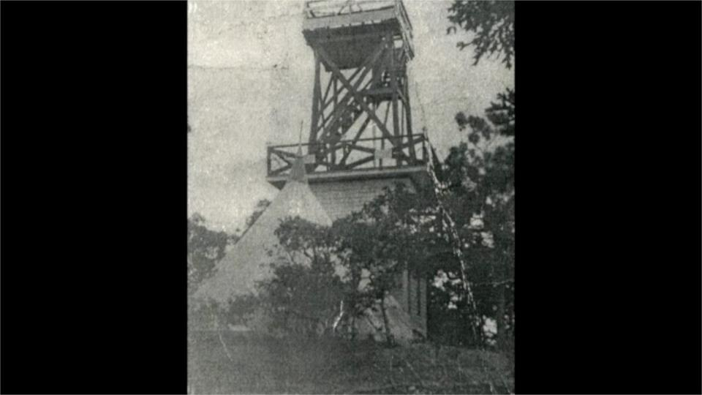
The girls slept in teepees – this one by the tower
Notes:
4 – more of a view and note the teepee – the girls slept in these – this one by the tower and it is known that others were located where the lodge is today.

Slide 4
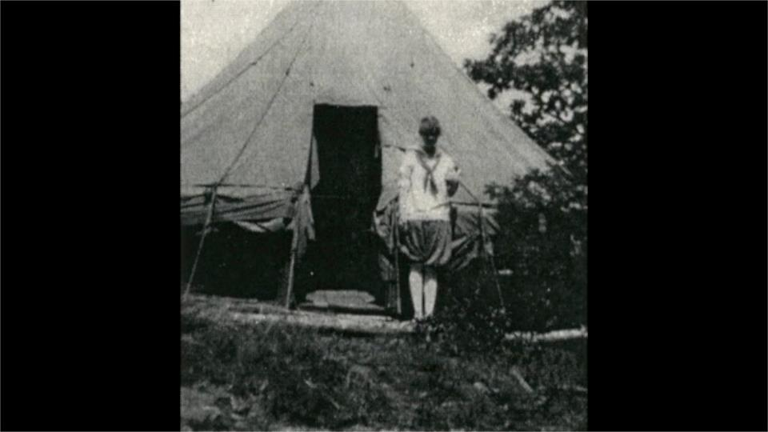
Camper in front of her teepee on location where lodge is today
Notes:
5- camper in front of her teepee: note how they allowed air in there during the day

Slide 5
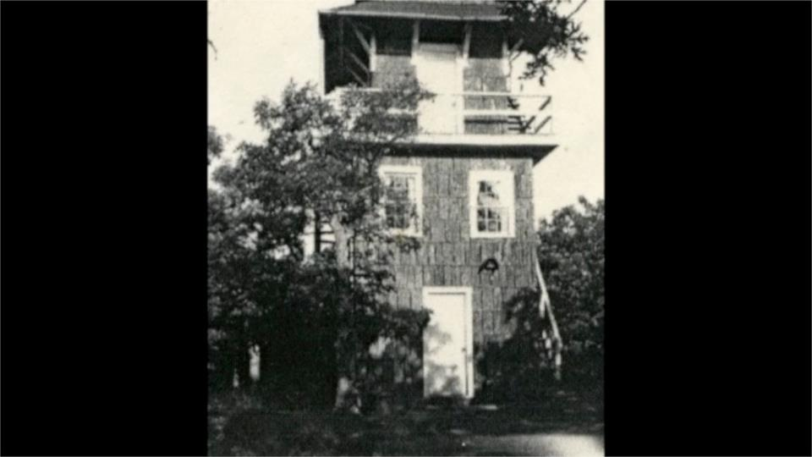
A tower with chestnut siding –shape-wise like the current tower
Notes:
4 – A later tower version with chestnut siding –shape-wise like the current tower

Slide 6
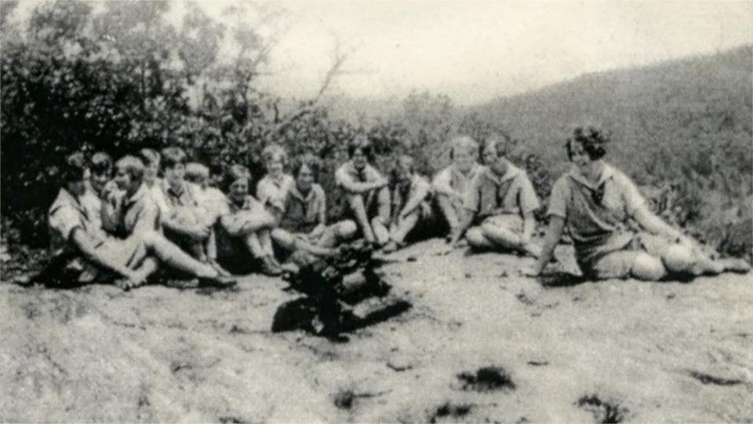
They gathered for camp fires on Meditation Rock
Notes:
7-They gathered for camp fires on Meditation Rock

Slide 7
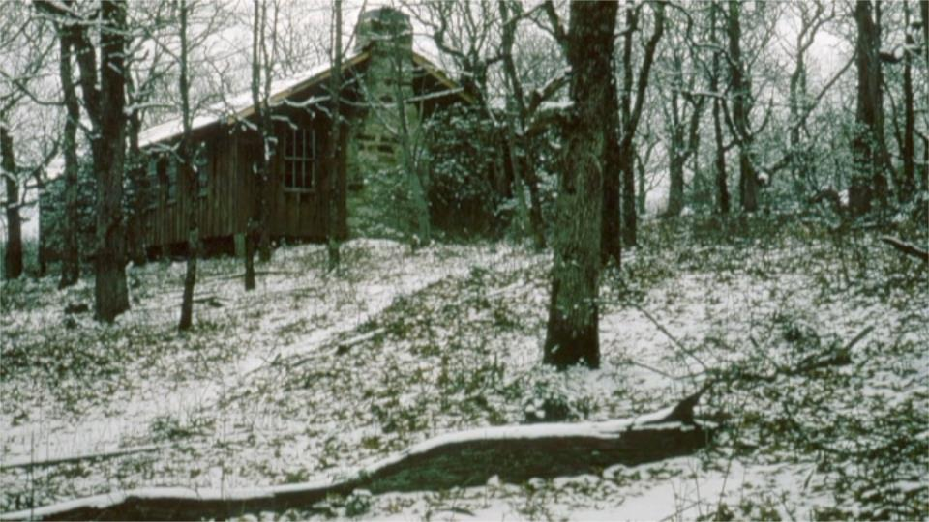
The original REC Hall was immediately built as their large indoor space
Notes:
16 – what the old REC Hall looked like

Slide 8
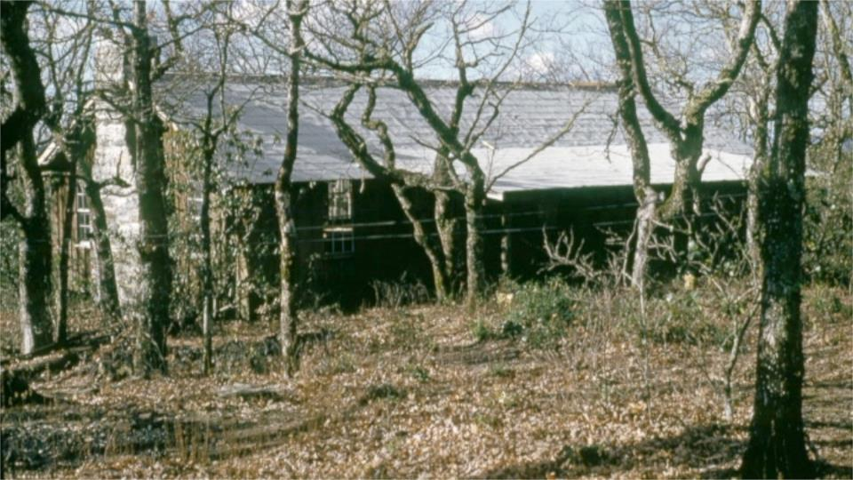
This view of the REC Hall from uphill
Notes:
17 – this view of the REC Hall from uphill

Slide 9
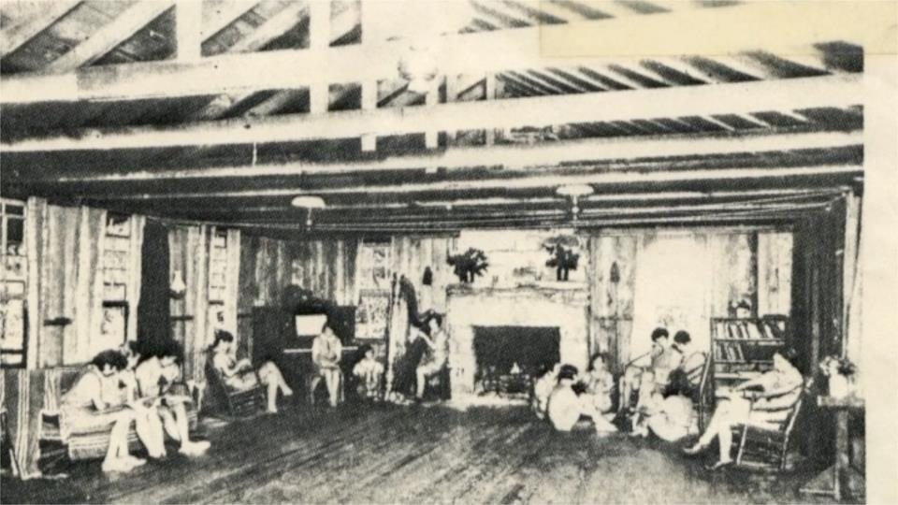
Enjoying the space including a harpist providing music
Notes:
8-the original REC Hall was immediately built as their large indoor space.

Slide 10
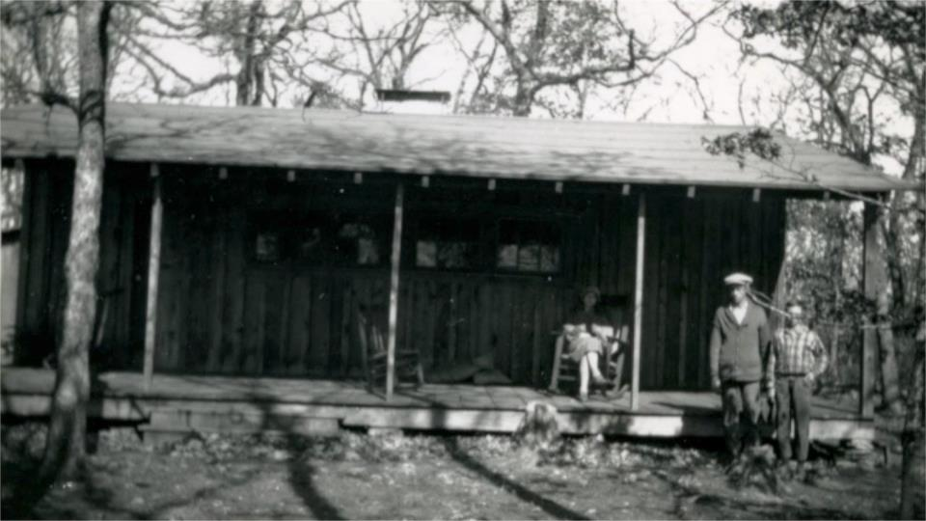
Early look at what is called the ASCENDER Home today - built early on – providing multiple uses: staff sleeping quarters, kitchen dining, etc. In the late 40’s the Parry’s built the structure now called EMERSON for their own family use. The 50’s found Maude older and her energy just wasn’t there. The camp likely was mostly unused in those years and was eventually put on the market
Notes:
11- Early look at what is called the ASCENDER Home today. This was built by the Parry’s early on – providing multiple uses: sleeping quarters, kitchen dining, etc. This picture shows the side that faces today’s paved road.
World War II essentially led to the ending of this first camp. In the late 40’s the Parry Family eventually built the structure now called EMERSON for their own family to use. The 50’s found Maude older and her energy just wasn’t there. It likely was mostly unused in those years and eventually was put on the market.
Ben Wax worked at the YMCA in Baton Rouge, LA and his dream was to own and run a boys camp in the mountains of North Carolina. That led him to the Highlands area in the mid-1950’s and his searching included driving down Rte 106 from Highlands toward Scaly Mtn Village and then turning around and came back up and saw off to the right a mountain that looked to have great views and so started searching for a way to get to the top of it and succeeded – not sure what kind of road there was.
That trip led to the purchase of the property from the Parry family and the creation of much of what exists at The Mountain today.

Slide 11
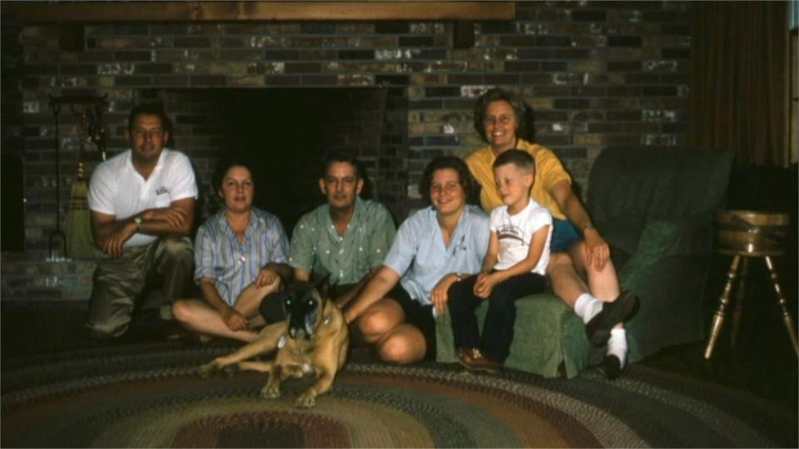
The Ben and Polly Wax Family – Camp Highlander for Boys – 1956/67 Ben Wax worked at the YMCA in Baton Rouge, LA and his dream was to own and run a boys camp in the mountains of North Carolina. That led him to the Highlands area in the mid-1950’s and the purchase of the property from the Parry family and the creation of much of what exists at The Mountain today. This is their family – with them in front of the fireplace in the home they built on the edge of The Mountain which was called the Lodge when UUs bought the property.
Notes:
12 – The Ben and Polly Wax Family – Camp Highlander for Boys – 1956/7
This is their family –in front of the fireplace in the home they built on the edge of The Mountain which was named the Lodge when UUs bought the property. Both Ben and Polly have died but daughter Ann still lives in Highlands, and son, Ben Jr, resides in Asheville. We have relationships with both the Parry and Wax families.

Slide 12
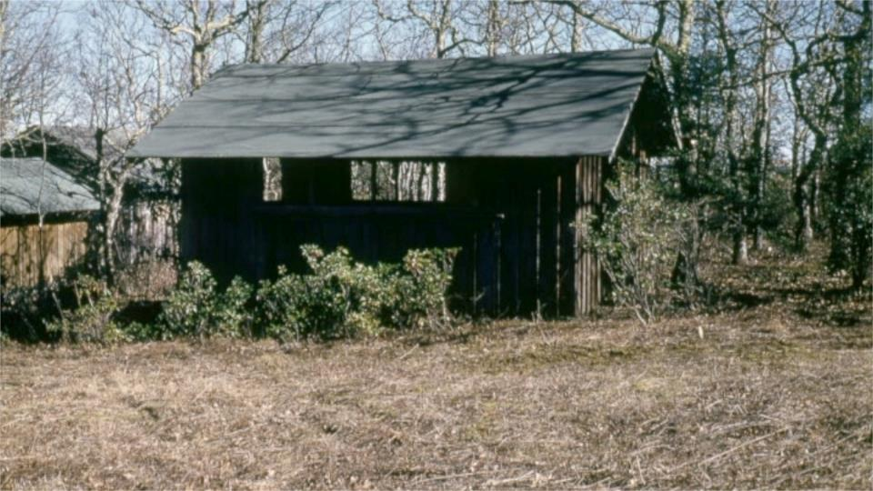
At the edge of the White Oak parking lot was their arts & crafts building -today office and space
Notes:
20—at the edge of the White Oak parking lot this was used as arts & crafts building probably by both Parrydise & Highlander – today office space & housing

Slide 13
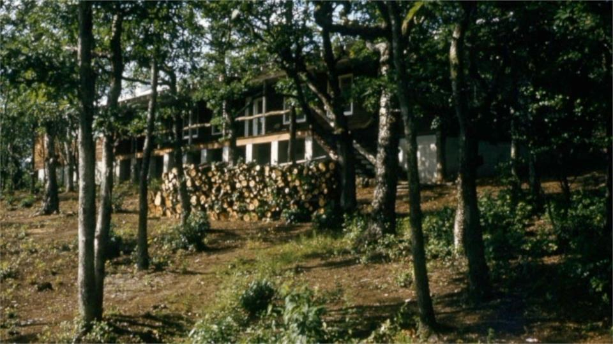
Lots of construction by the Wax’s with a dining hall top of the list
Notes:
21 – Lots of construction by the Wax’s with a dining hall/game room top of the list

Slide 14
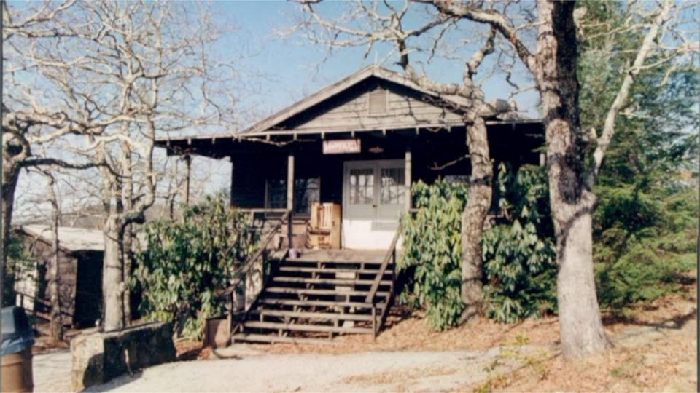
Front view of that building with water fountain
Notes:
23 – not actually a 50’s shot but what that front of dining hall building looked like then

Slide 15
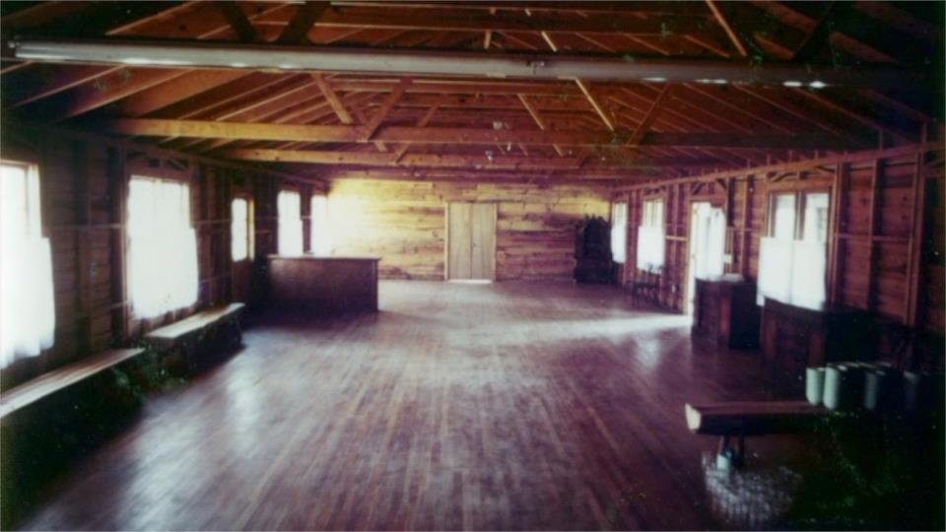
How the interior part of the Dining Hall building looked in 1979
Notes:
54 – Here’s what was seen in early 1979 as we took pictures to educate UUs across the Southeast and beyond: an empty Dining Hall in one end of a building that had two parts to it with bathrooms in between

Slide 16
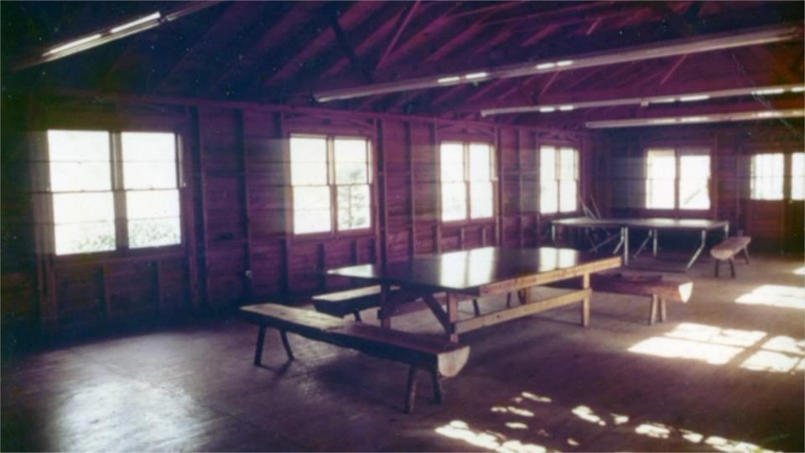
Game room was at the front end
Notes:
55 – and a game room on the other end

Slide 17
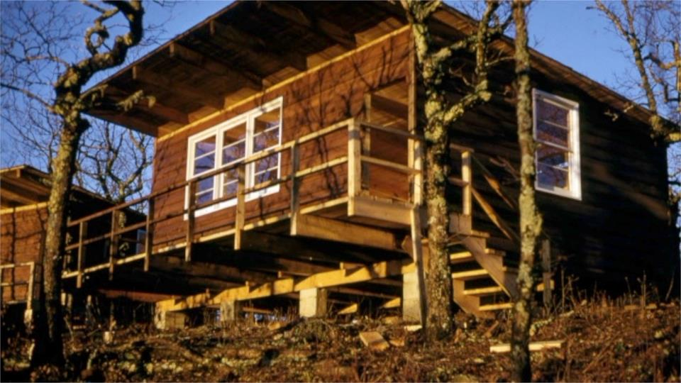
Building of the cabins around the edge of the mountain – all bunkhouses but all with sinks and bathrooms! THIS MADE A HUGE POSITIVE DIFFERENCE TO THE 1979 SEARCH GROUP
Notes:
24 – the building of the cabins around the edge of the mountain – all bunkhouses but also with sinks and bathrooms because Ben Wax’s boys back home said that was their pet peeve with where they had previously gone to camp.

Slide 18
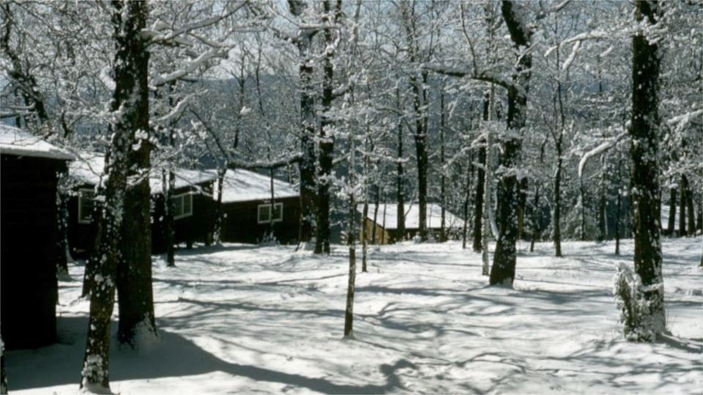
Note that no road was initially built to the cabins
Notes:
26 – note no road was built to the cabins at the time

Slide 19
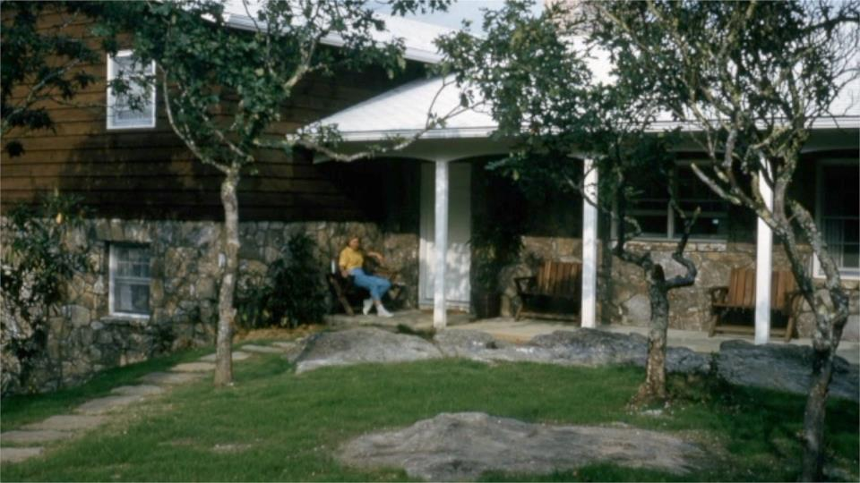
The Waxes built their dream home (the original lodge as seen in 1979) – 5 BR, 3 baths, big family room and big living room – another key positive for the Search Group
Notes:
27 – The Waxes built their dream home ( we named it the lodge in 1979) – 5 BR, 3 baths, big family room and big living room – three of them with nice picture windows and fire places.

Slide 20
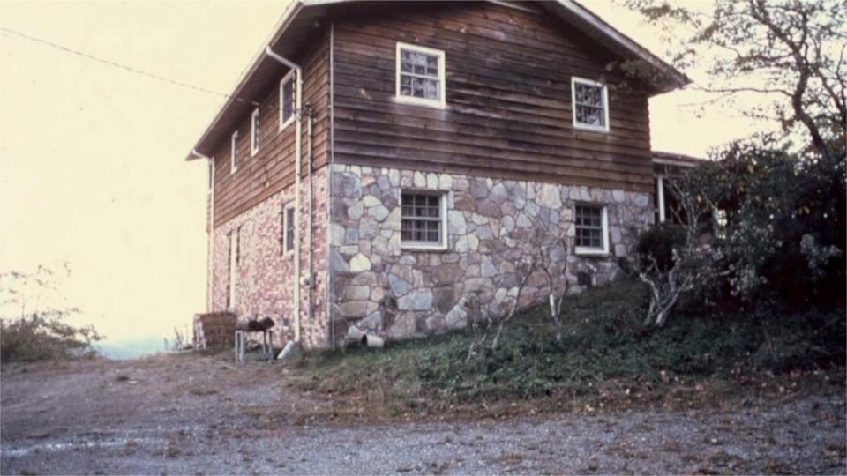
Looking around the outside
Notes:
29 – this place made a real difference with heat, fireplaces and kitchen

Slide 21
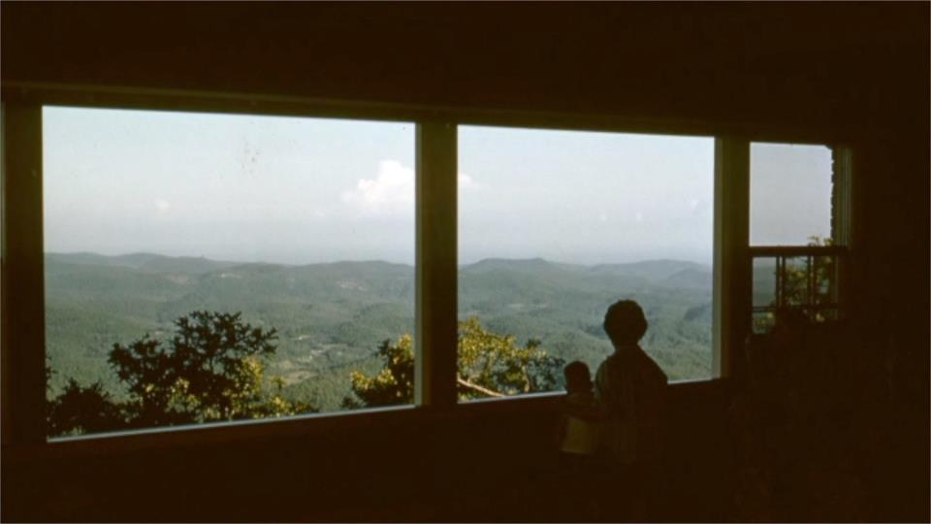
Wonderful views from the living room’s windows
Notes:
30 – the living room with three wonderful picture windows and a big fire place

Slide 22
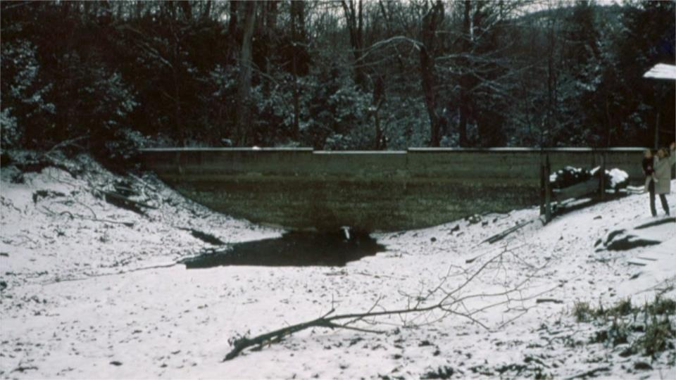
Building the big lake was a huge project – started below the small 2nd lake dam
Notes:
33– Building the big lake was a huge project as the next few pictures show – here is the Lake #2 dam below which becomes the new lake

Slide 23
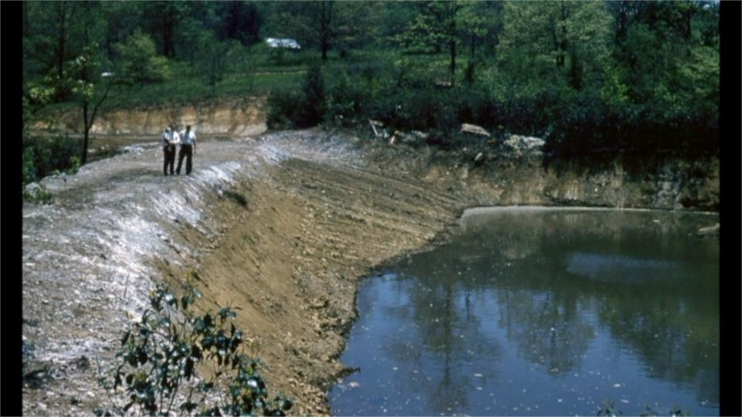
Lots of earth moving for the dam shown nearing completion
Notes:
36– the dam nearing completion

Slide 24
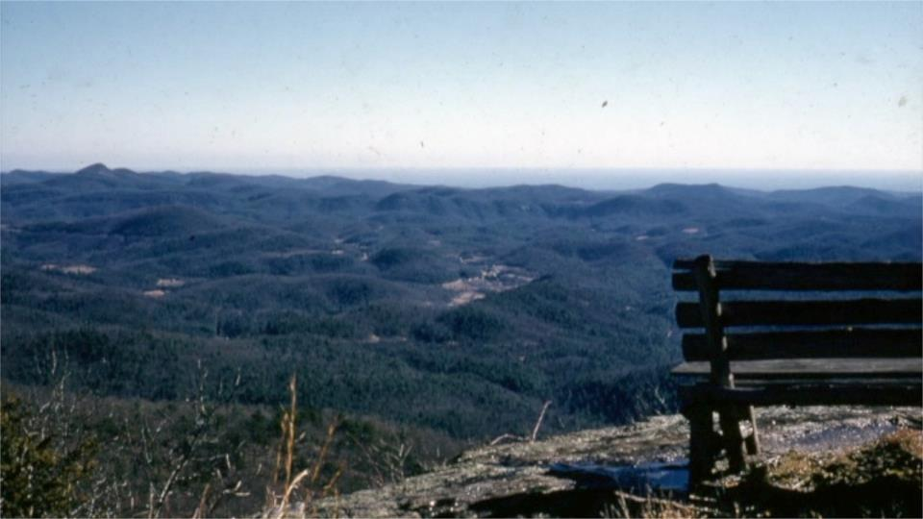
Back on top, the views have always been a big deal
Notes:
37 – back on top the views have always been a big deal –this Meditation Rock

Slide 25
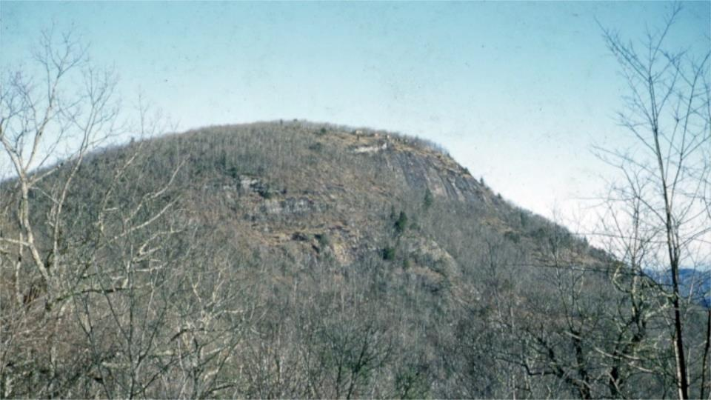
…and from the highway it’s always fun to see the cabins on the edge of the cliffs
Notes:
38 – and from the highway it’s always fun to see the cabins on the edge of the cliffs

Slide 26
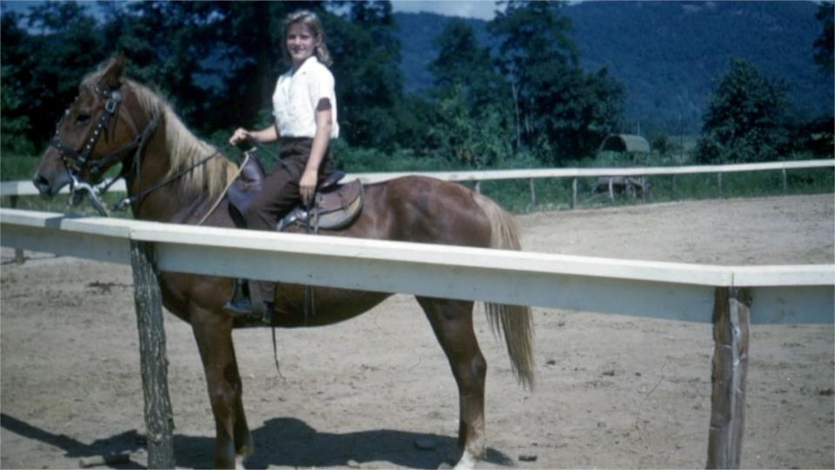
Yes, the first Camp Highlander was a boy’s camp but the horse instructors were all female. There were three horse rings and two big stables
Notes:
39 -- Yes, the first Camp Highlander was a boy’s camp but the horse instructors were female

Slide 27
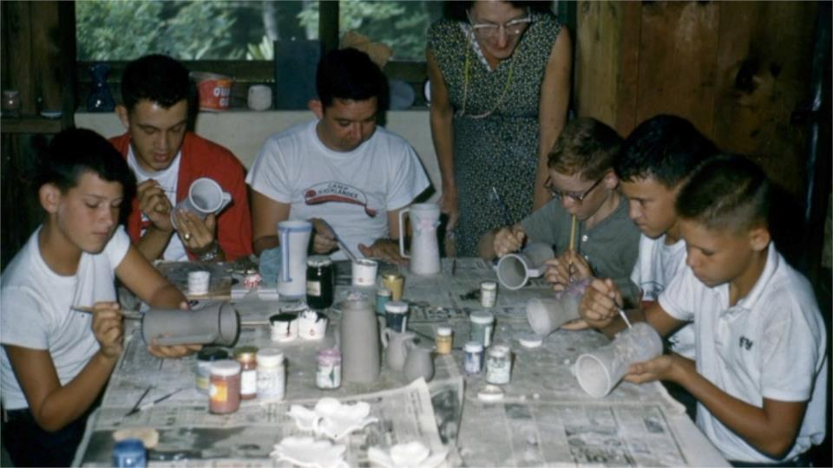
Arts and crafts a standard
Notes:
43 – Arts and crafts a standard

Slide 28
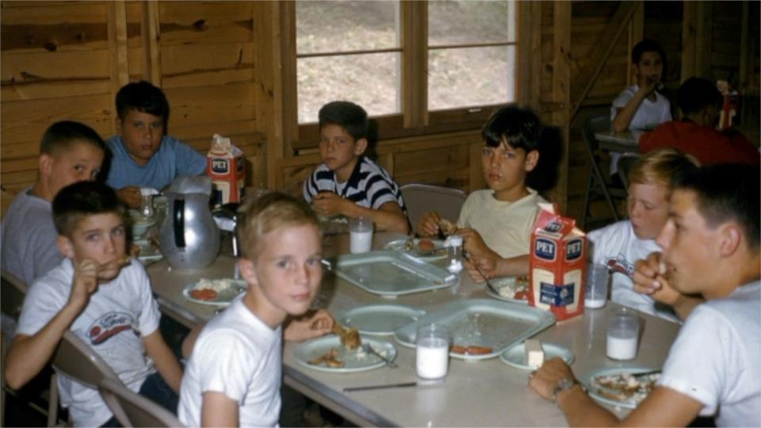
Meals in the new dining hall – note the walls, not insulated until after we got here
Notes:
44 – meals in the new dining hall – note the walls, not insulated until after we got here and am betting the windows were the same ones replaced by us in 2018!

Slide 29
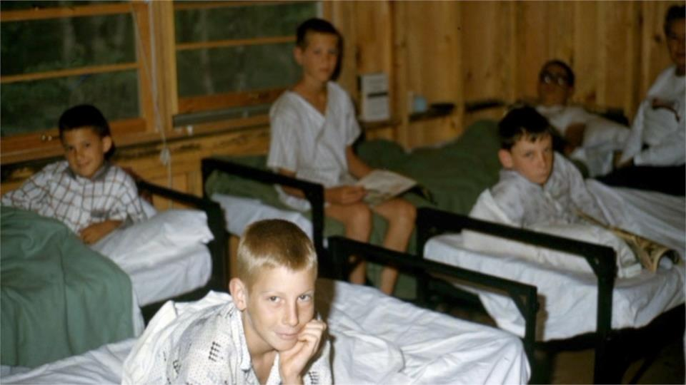
Sleeping in the newly built cabins – didn’t stack the bunks
Notes:
45 –sleeping in the newly built cabins – didn’t stack the beds and same comments re insulation and windows

Slide 30
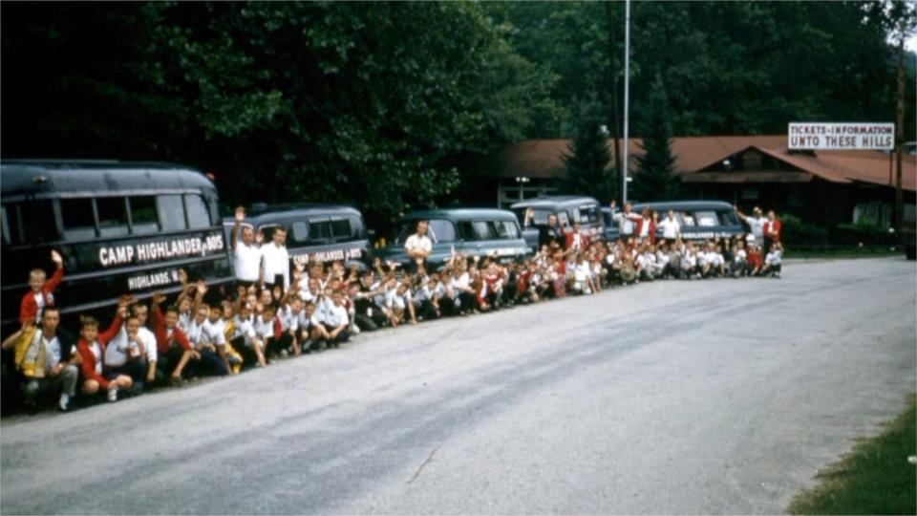
They took trips with their fleet of vehicles – here in Cherokee posing for camera
Notes:
48 – this trip was to Cherokee where they posed for a group picture

Slide 31
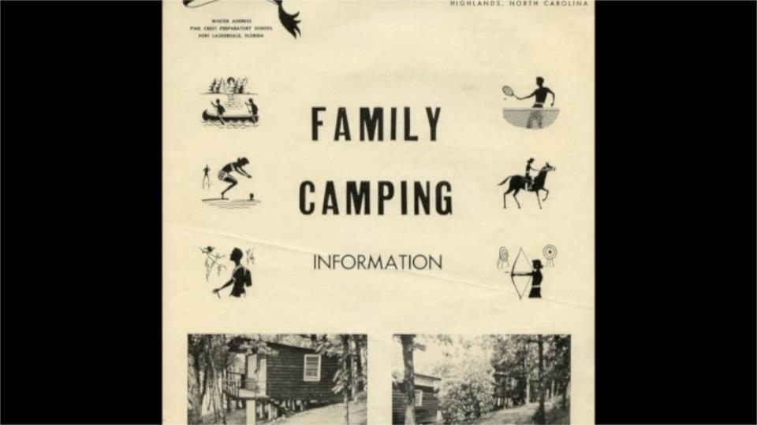
Sadly, Ben Wax needed to sell the property in the early 60’s due to his declining health. The buyer was the Pinecrest School in Ft Lauderdale, FL and they kept the Camp Highlander name but turned it into a co-ed camp and rented some of the cabins for non camp families
Notes:
50 – note the brochure shows they were trying to rent the lodge and even some cabins in addition to their regular camp schedule

Slide 32
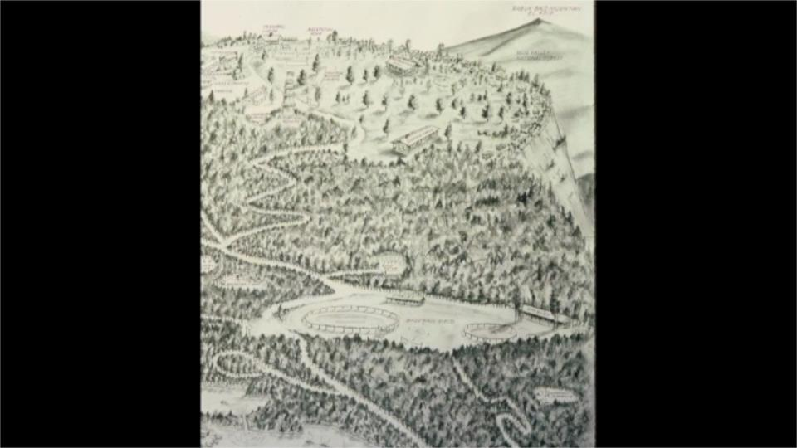
This was their map of the camp. They built larger cabins 1-4 and had big bunkhouses there, but the sense was they had too many campers and not particularly good stewards of the property. They realized by early 70’s that they needed to move (more space, easier airport travel, etc.) and so bought a place just outside Hendersonville where Camp Highlander still exists.
Notes:
51-- here is a drawing showing all they had going on
They built larger cabins 1-4 and had big bunkhouses there, but the feeling in looking at the place was that they had too many campers and weren’t particularly good stewards of the property – for example, lots of trails that shouldn’t have been where they were
They finally realized in the early 70’s that they needed to move (more space, easier airport travel, etc.) and so they bought a place just outside Hendersonville where Camp Highlander still exists.

Slide 33
The next owners were planning a family resort called Country Mountain but it came about at a bad economic time and they folded in 1975. But in their short time built 2 beautiful tennis courts at the base of the mountain replacing the big horse ring. On top they put kitchenettes in cabins 3, 4 and what was 5 (now the office) and started converting some bunk houses to include a bedroom with a door for adults with kids in beds in the rest of the cabin.
Notes:
52 -- The next owners were planning a family resort called Country Mountain but it came about at a bad economic time and they folded in 1975. The property then reverted back to Pinecrest and was vacant for 4 years. But in their short time there they made some useful changes to the facilities – building 2 beautiful tennis courts at the base of the mountain replacing the big horse ring. On top they put kitchenettes in cabins 3, 4 and what was 5 (now the office) and started converting some bunk houses to include a bedroom with a door for adults with kids in beds in the rest of the cabin.

Slide 34
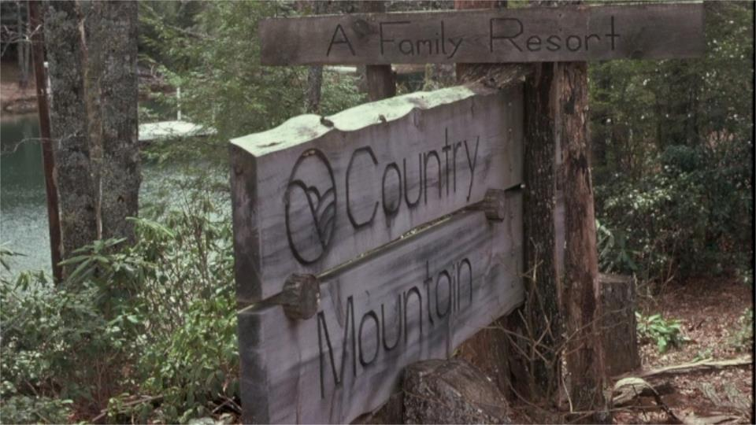
The Country Mountain sign proved helpful to us later on but the property reverted back to Pinecrest and was vacant for 4 years when Search Group visited in February, 1979. The Committee came away saying YES -- this is the place! Very favorable formal market research study and the same strong results from the congregational leadership study distributed widely along with a slide show.
Notes:
53 – When our Site Search Committee visited in Feb, 1979. The Committee went away saying YES -- this is the place! As site selection was finishing up the leadership distributed the very favorable formal market research study and the same strong results from the congregational leadership study. Their sign was also noted as one that we could convert to our own use.

Slide 35
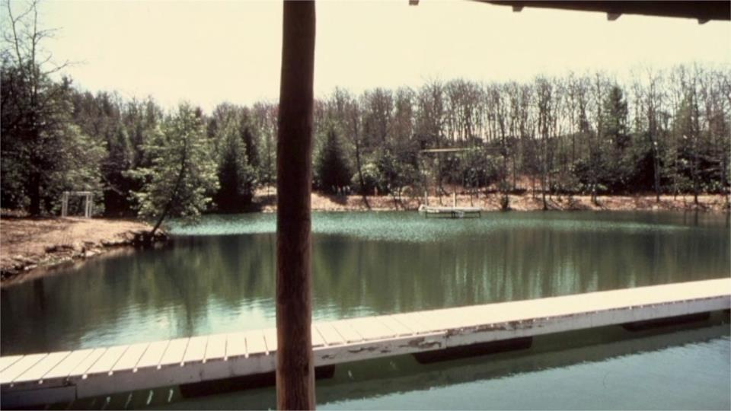
The lake as it looked in 1979
Notes:
56 – the lake from the Highway 106 side

Slide 36
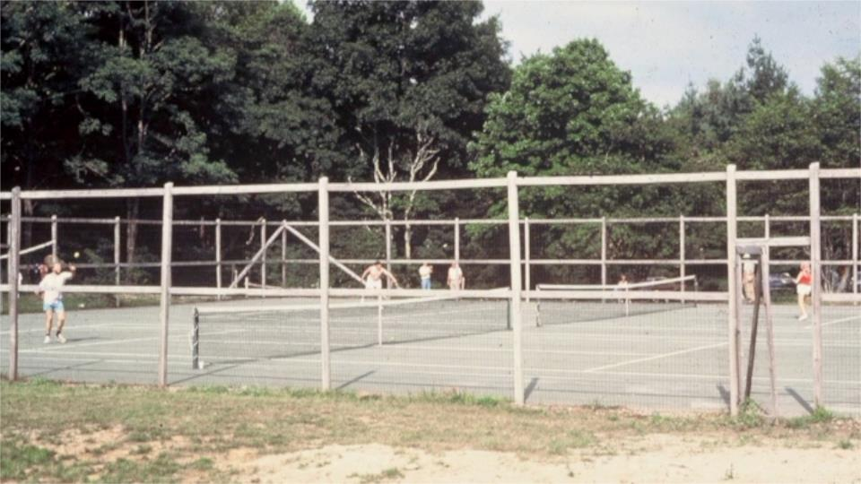
…and the nice tennis courts
Notes:
60–while down below there were the two very nice tennis Courts that Country Mountain had put in

Slide 37
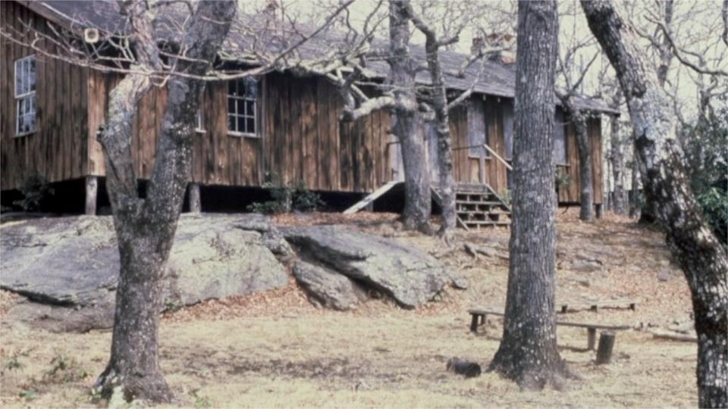
First story REC Hall as we found it
Notes:
57 – 1 story REC Hall

Slide 38
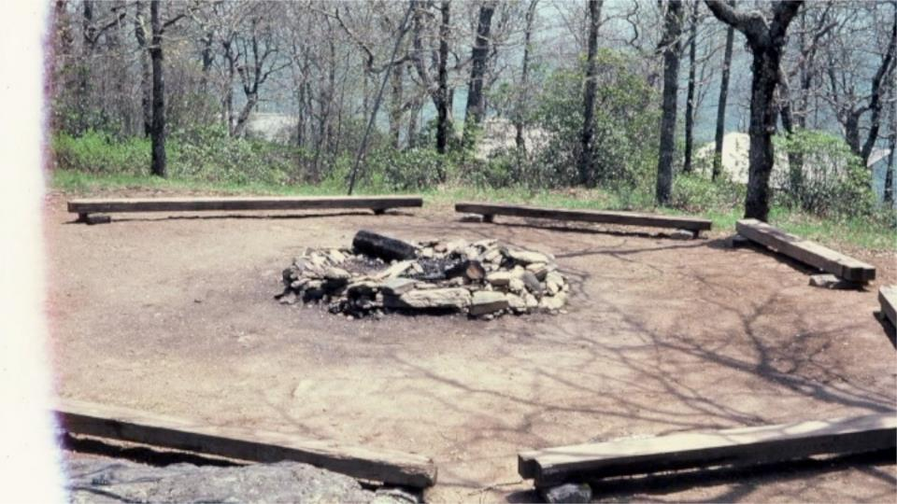
…and the fire ring in front of it
Notes:
58- and the fire ring in front of it

Slide 39
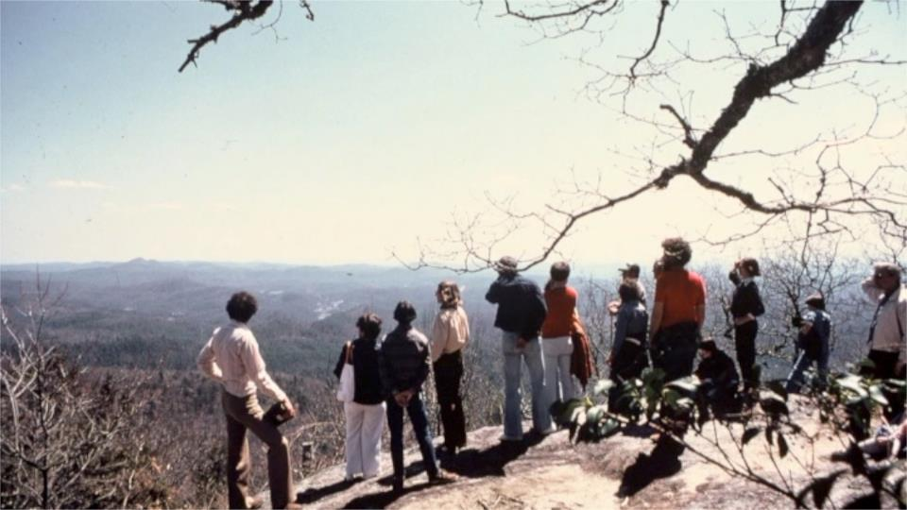
This is the beautiful 1979 April day with a meeting of the SUUSI Board, the Search Group and other key players met on Meditation Rock to decide whether to move forward to buy the place
Notes:
61 – this is the beautiful April day with a meeting of the SUUSI Board and other key players held on Meditation Rock making the decision whether to move forward to buy the place

Slide 40
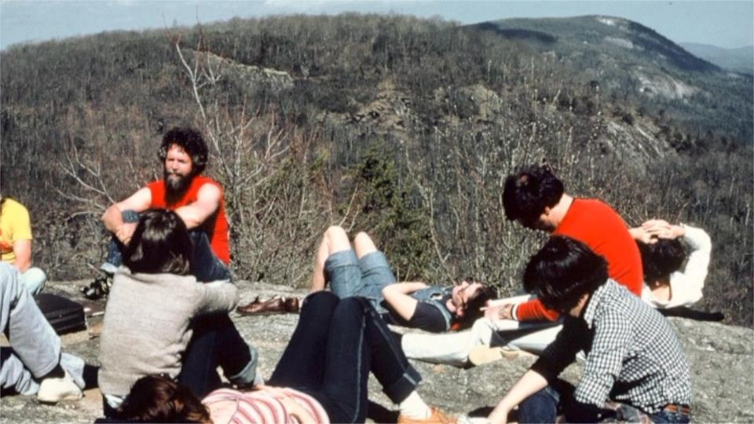
The groups sat for hours, finally deciding to move forward to buy the place. Soon thereafter agreement to a $400,000 contract and the ball was rolling. Much volunteer support came from the Franklin UU Fellowship. With permission, we started work weekends in late Spring to start fixing the place – months before the actual closing in mid-October. For example, almost every cabin toilet needed replacing. Water system and sewage systems also needed lots of work.
Notes:
62 – the groups sat for hours, finally deciding to move forward to buy the place. Soon thereafter Agreement to a $400,000 contract and the ball was rolling. Much support came from the Franklin UU Fellowship who were close to Highlands and particularly from Art & Myrtle Lockwood who made themselves available and brought others along as well.

Slide 41
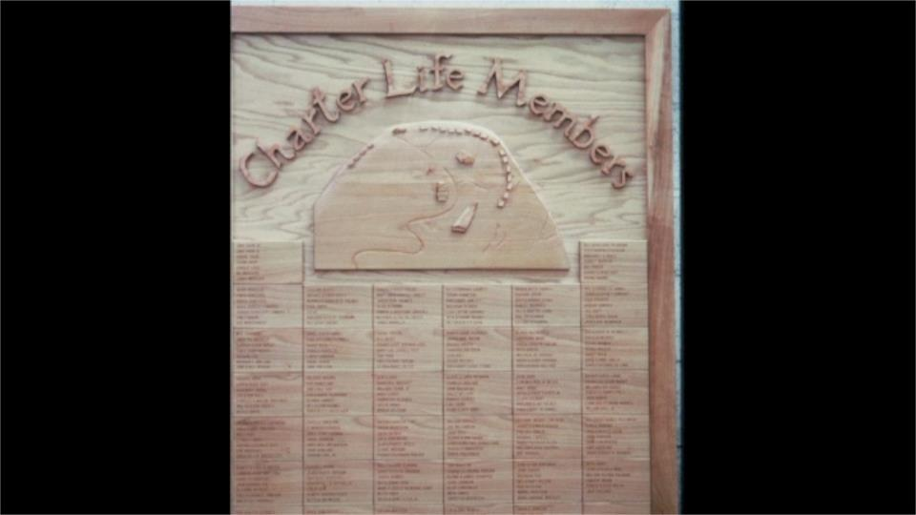
Our History Here, 1979 to the Present
Active fund raising soon started and thank you Charter Life Members who made sure it all happened! Roger Comstock was elected as the first Board President. Mo and Larry Wheeler were appointed as the first Directors
Notes:
64 – Active fund raising soon started and thank you Charter Life Members who made sure it all happened!

Slide 42
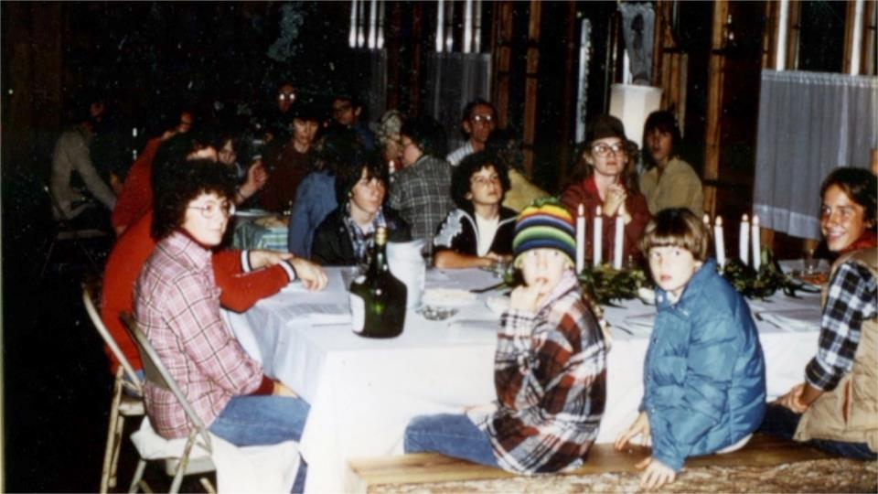
The first official event was Thanksgiving, 1979 as about 50 people huddled in the dining hall wearing outdoor clothing because no insulation and no heat. Turkeys were cooked in the Lodge, Emerson and the kitchen of the dining hall where one oven worked.
Notes:
65 – the first official event was Thanksgiving, 1979 as about 50 people huddled in the dining hall wearing outdoor clothing because no insulation and no heat. Turkeys were cooked in the Lodge, Emerson and the kitchen of the dining hall where one oven worked.

Slide 43
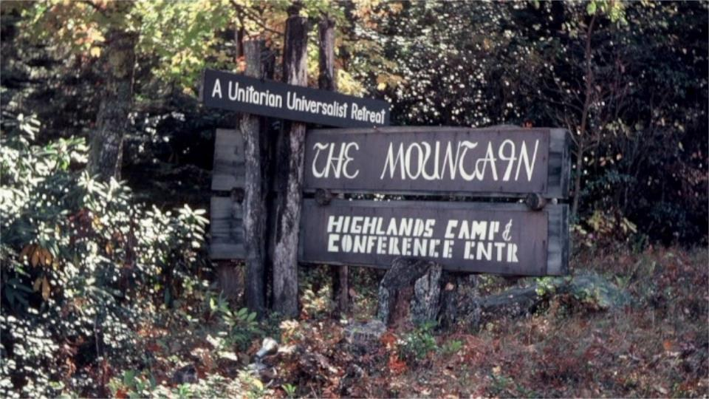
In the months ahead agreement to a formal name: HIGHLANDS CAMP & CONFERENCE CENTER and informally, THE MOUNTAIN, with the latter quickly becoming what people used.
Notes:
66 – In the months ahead agreement to a formal name: HIGHLANDS CAMP & CONFERENCE CENTER and informally, THE MOUNTAIN, with the latter quickly becoming what people used – and yes, the Country Mountain sign made it easy to layer over their wording.

Slide 44
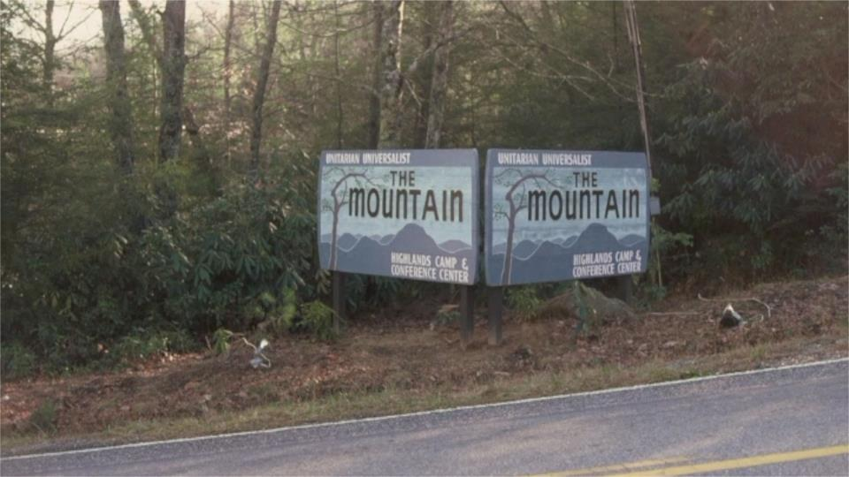
A later sign with views in two directions and showing our UU connection
Notes:
67- Later we invested in our own sign with views either direction

Slide 45
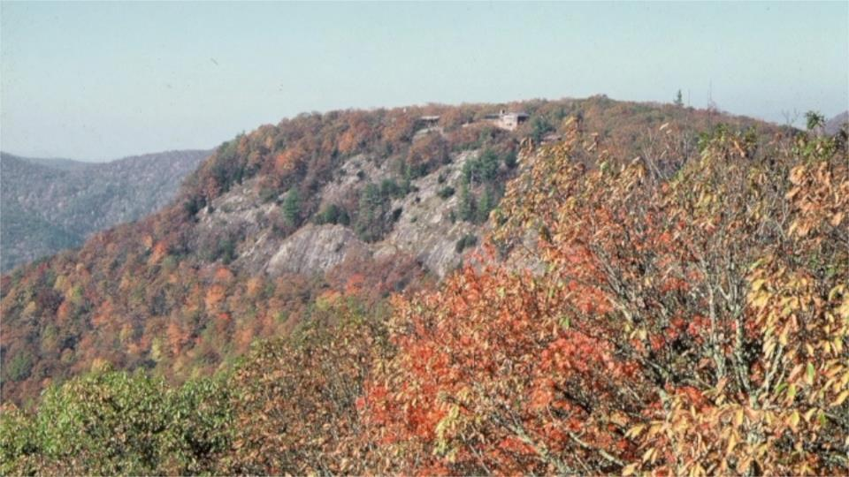
One of the special views from Chinquapin Mtn
Notes:
68 – again a view from Chinquapin Mtn of our special place

Slide 46
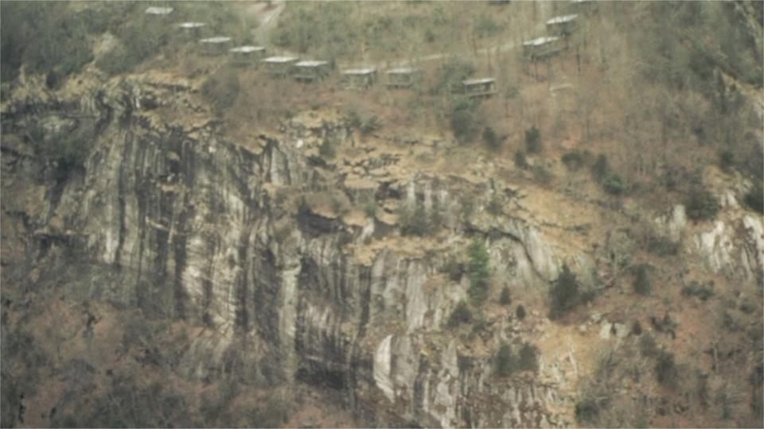
And another– cabins 11-20 plus Riley
Notes:
69 – And here from Jake Haun’s airplane – cabins 11-20 plus Riley
As the 79-80 winter came we learned what it was like travel up and down our road in the snow – often people parking at the bottom and walking both ways using sleds to put their gear on. Plans for the first year of camp were in the works when we received a phone call early in 1980 from a movie production company looking for a camp that could serve as a site for a movie to be filmed in April and May of 1980

Slide 47
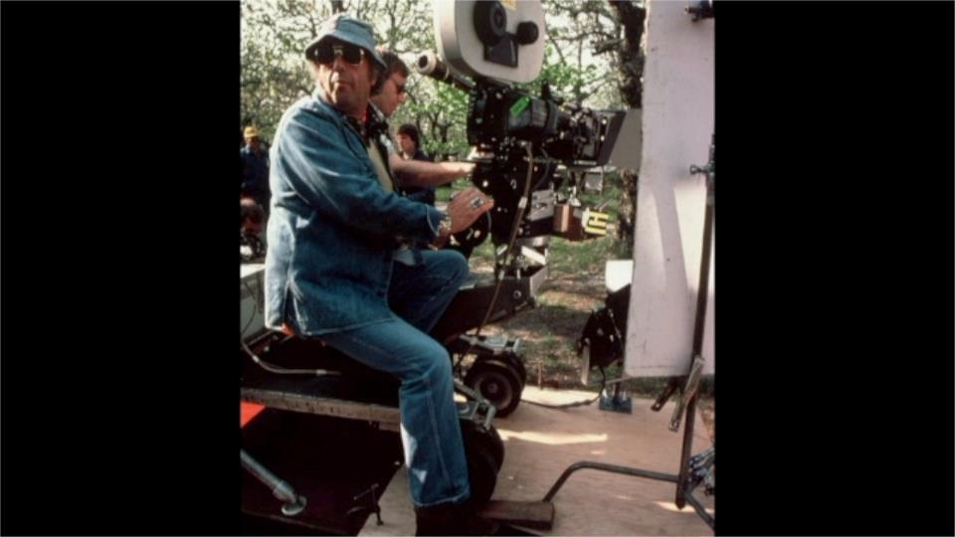
Plans for the first year of camp were in the works when we received a phone call from a movie production company looking for a run down camp that could serve as a site for a movie to be filmed in the Spring. Soon we found ourselves playing hosts to a movie crew, lots of equipment, and about 20 Western Carolina students who served as support staff for them. The movie was called “The Mating Season” where The Mountain became the Highlands Bird & Nature Camp.
Notes:
70- Soon we found ourselves playing hosts to a CBS Television movie crew, lots of equipment, about 20 Western Carolina students who served as support staff for them. The movie was called “The Mating Season” where The Mountain became the Highlands Bird & Nature Camp.

Slide 48
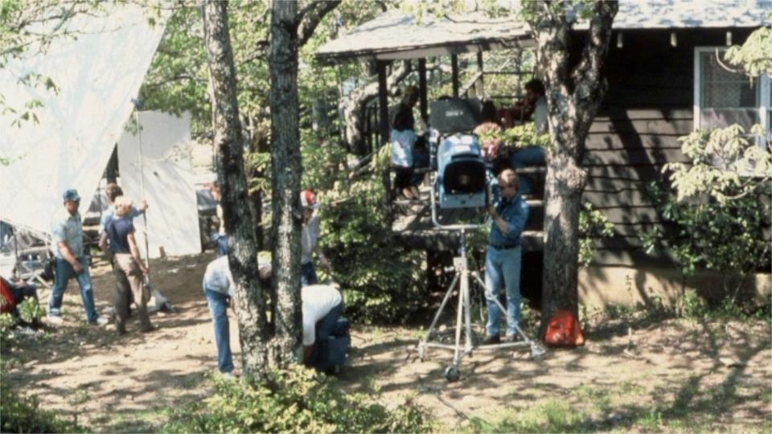
It starred Lucie Arnaz & husband Larry Luckinbill, plus newcomers Swoosie Kurtz and Joel Brooks. Financially, it helped to ensure an OK year financially but tested everyone’s patience. LOTS OF STORIES TO SHARE. It aired on CBS on Dec 30, 1980.
Notes:
72-This is the front of the then dining hall building. Of interest—after the movie played on CBS in 1980, the Highlands Post Office delivered six letters addressed to Highlands Bird & Nature Camp from people wanting to attend a summer program to learn about birds and nature.

Slide 49
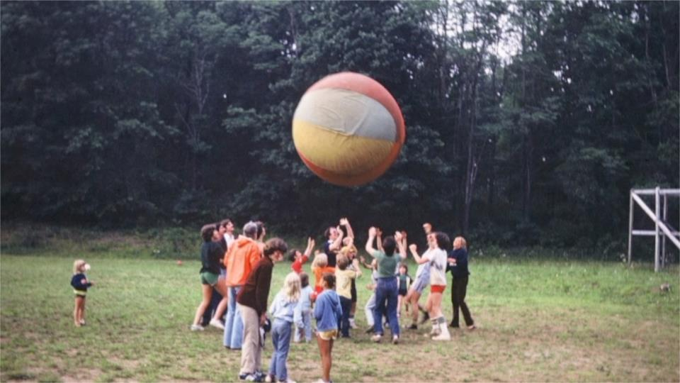
The next several pictures are from the early years’ summer programming – here, keeping the earth ball in the air
Notes:
74- once the movie crew was gone we got on with the prime reasons behind the whole concept of having this place. The next several pictures are from the early years’ summer programming – here, keeping the earth ball in the air

Slide 50
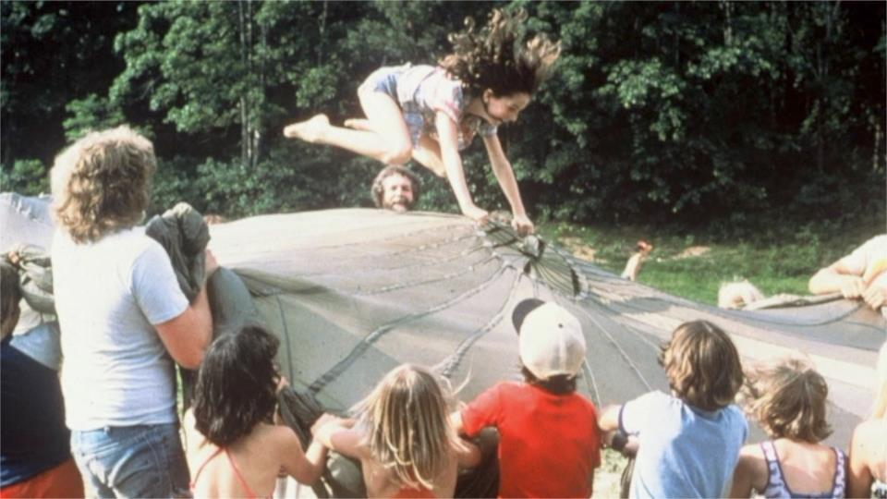
All sorts of things to do with a parachute
Notes:
76- All sorts of things to do with a parachute

Slide 51
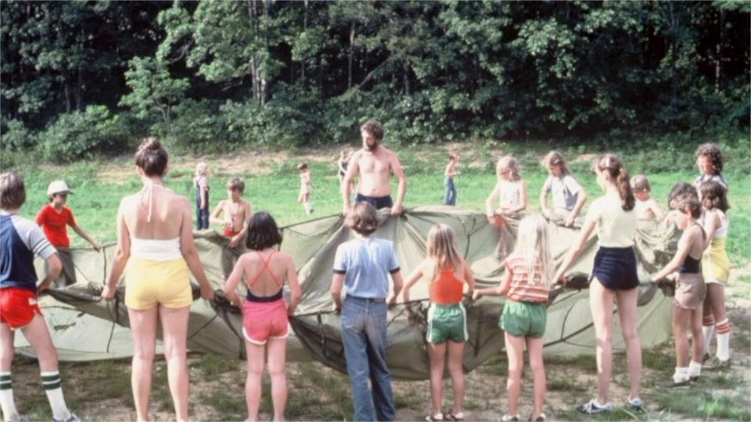
Notes:
77, 78, 79-- Lots of people of all ages around the parachute in a sequence of 3 pictures

Slide 52
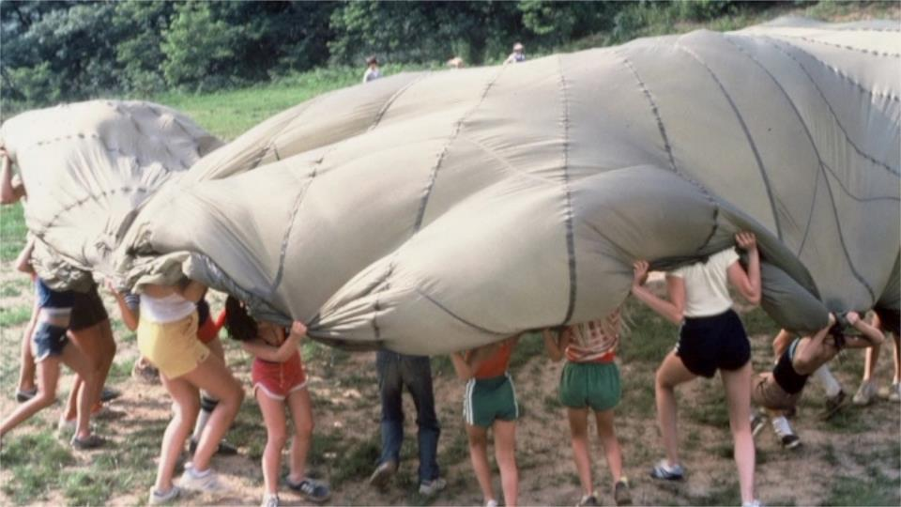
Notes:
#2

Slide 53
Notes:
And #3

Slide 54
Successfully catching the water balloon didn’t always work out
Notes:
80- Successfully catching the water balloon didn’t always work out

Slide 55
We had a horse program for the first 6-7 years – we had stables, a horse ring and a fenced pasture area
Notes:
81-We had a horse program for the first 6-7 years – we had stables, a horse ring and a fenced pasture area

Slide 56
Campfires at the REC Hall were popular
Notes:
83- Campfires at the REC Hall were popular

Slide 57
Fun camp nights – this is the popular Sr Hi Camp Air Band
Notes:
85- Fun camp nights – this is the popular Sr Hi Camp Air Band

Slide 58
Cabin Dress up night
Notes:
86- Cabin Dress up night

Slide 59
The arts & crafts program moved quickly to a stable that was remodeled for that purpose. Evelyn Carter, wife of Steve Carter, our first Facilities Manager, built an amazing program!
Notes:
87- The arts & crafts program moved quickly to a stable that was remodeled for that purpose. Evelyn Carter built an amazing program!

Slide 60
Lots of creativity was shown
Notes:
88- lots of creativity was shown

Slide 61
In the early 80’s the yellow bus was a big hit with many stories to be told
Notes:
89- In the early 80’s the yellow bus was a big hit, again with many stories to be told

Slide 62
Pam Phelps – on the far left had a huge impact in building the youth programs
Notes:
90- Pam Phelps –on the far left had a huge impact in building the very successful youth programs

Slide 63
A camp picture from the early 80’s with campers and counselors
Notes:
91- A camp picture from the early 80’s with campers and counselors

Slide 64
Summer staff in the early 80’s
Notes:
92- Summer staff in the early 80’s

Slide 65
Lots of adult programs also took place in the summer- break out group from Theology thru Biography led by Rev David Rankin, sitting outside the REC Hall above the fire ring
Notes:
94- There were lots of adult programs that also took place in the summer. This is a break out group from Theology thru Biography led by Rev David Rankin – sitting outside the REC Hall above the fire ring.

Slide 66
We had a minister of the week who always started with the Sunday morning service that drew people from Highlands as well.
Notes:
95- We had a minister of the week who always started with the Sunday morning service that drew people from Highlands as well. This slide shows Rev. Terry Sweetser, who served the UU Congregation of Atlanta at the time.

Slide 67
Evening vespers – this one led by Rev Don Male on Meditation Rock, with Lee Knight playing his guitar
Notes:
96- Evening vespers were held – this one led by Rev Don Male on Meditation Rock, with Lee Knight playing his guitar.

Slide 68
…and meals at the base of The Mountain
Notes:
99- and serving meals

Slide 69
People of all ages have learned about the wildlife in the area – here, with some hesitation, getting up close to a large hawk.
Notes:
100- people of all ages have learned about the wildlife in the area – here, with some hesitation, getting up close to a large hawk.

Slide 70
The next several slides offer views of our Outstanding Outdoor Programming, led the first 6 years by Nancy Heath. There were water activities galore, starting with Pot Hole slide – a favorite all these years
Notes:
102- Pot Hole slide – a favorite all these years!

Slide 71
Here’s a group at the base of Glen Falls
Notes:
103- Here’s a group at the base of Glen Falls.

Slide 72
Day and night trips under Dry Falls
Notes:
104-Day and night trips under Dry Falls.

Slide 73
2nd falls at Glen Falls after lots of rain!
Notes:
105- 2nd falls at Glen Falls after lots of rain!

Slide 74
Rainbow Falls – just down stream from
Notes:
106- Rainbow Falls – just down stream from…

Slide 75
Turtle Falls – 30 ft slide and then a 10 foot drop. Both are now part of Gorges State Park
Notes:
107- Turtle Falls – 30 ft slide and then a 10 foot drop – both of these now in Gorges State Park

Slide 76
Here she comes over Turtle Falls
Notes:
108- Here she comes

Slide 77
…and there she goes
Notes:
109- and there she goes

Slide 78
–lots of fun on our own lake
Notes:
110- Lots of fun on our own lake.

Slide 79
All sorts of things to do at the lake
Notes:
111- All sorts of things to do at the lake

Slide 80
Many learned white water rafting, canoeing and kayaking because of this program
Notes:
Many experienced white water rafting, canoeing and kayaking thanks to the leadership of Nancy Heath in the first 6 years

Slide 81
Here, Nancy Heath instructing Elderhostel students ahead of a rafting trip
Notes:
113- Here, Nancy instructing Elderhostel students ahead of a rafting trip

Slide 82
Elvin and Nancy Hilyer created the Work and Adventure Program – lots of new experiences
Notes:
114- Elvin and Nancy Hilyer created the Work and Adventure Program – lots of new experiences

Slide 83
Class 5 Bull Sluice Rapid on the Chattooga River
Notes:
116- Much excitement being on the Chattooga River going through Class five Bull Sluice – 3 pictures.

Slide 84
And Climbing – both on our cliffs and elsewhere in the area
Notes:
119 - And Climbing – both on our cliffs and elsewhere in the area

Slide 85
Ken Kortemier leading the program with ease
Notes:
121- Ken Kortemier led the program with ease.

Slide 86
Most campers doing this for the first time
Notes:
122- Most campers were doing this for the first time

Slide 87
Work Adventure Camp gave campers lots of experience in the outdoors – 24 hrs/day. They rebuilt this tent platform.
Notes:
123- Work Adventure campers had lots of experience in the outdoors – 24 hours a day!

Slide 88
Outdoor adventures on the ground
Notes:
125 – Outdoor adventures on the ground and 40 feet above the ground

Slide 89
…and 40 feet above it
Notes:
129-

Slide 90
Most ages can work on these
Notes:
130-

Slide 91
Notes:
131-

Slide 92
The Labyrinth is a favorite quiet time experience for many
Notes:
132- The Labyrinth is a favorite quiet time experience for many.

Slide 93
Sally Bellamy--it’s the summer of 1980 – the one and only guest to the first program. Went home and drove back the next week . For many years she arrived in April when Elderhostel programs started and stay until they ended in late October
Notes:
133- This is Sally Bellamy--it’s the summer of 1980 – youth camps were starting and at the same time the first adult program was scheduled. There was exactly one guest – Sally Bellamy from Tallahassee, FL. The lore of The Mountain is that she never left. Not quite true. Sally went back home at the end of that week and quickly repacked for the whole summer and drove back. For many years to come she would arrive in April when Elderhostel programs started and stay until they ended in late October. She ran the store and hosted Social Hour, handled Town Run, mail, extra groceries for the kitchen, laundry, etc.

Slide 94
She ran the store and hosted Social Hour, handled Town Run, mail, extra groceries for the kitchen, laundry, etc.
Notes:
134- Early one summer, Doris Gove, who was running the Nature Center in Highlands asked The Mountain staff to be on the lookout for any kinds of snakes and to catch them and then call her to see if she still needed it. One day there was a handsome garter snake that appeared and she wanted it. So it was placed in a knotted pillow case and given to Sally to deliver it. That was a busy town run that also included a grocery stop, mail, and lots of linen for the laundry to wash. That afternoon there was a call to the office from the laundry inquiring if there was any chance that we might have delivered them a garter snake in a pillow case. Yes, the snake got washed but amazingly enough survived. The Highlands Paper that week had a front page story about the incident and a picture featuring Sally, the laundry owner and the Nature Center Director holding what was labeled as THE CLEANEST SNAKE IN TOWN.

Slide 95
This was the store back then, now named White Oak, and giving us great meeting space.
Notes:
135- This was the store back then, now named White Oak.

Slide 96
Sally sold the concept of having a deck on the side of the Lodge to “greatly improve social hour”
Notes:
137- Sally often found projects she believed ought to be undertaken and would show up at the Directors’ office, close the door and explain why her project should be done, and immediately. The biggest one involved – in her words -- “greatly improving social hour”. Social Hour was being done in the Living Room of the original lodge. Sally said it was getting too crowded and that The Mountain needed a deck attached to the Lodge. In her mind the only question was HOW SOON it would be built. Well, the idea caught fire, Sally gave generously to it, and a campaign was started with the help of Christine Lucas to have “all Sally’s children” give to this project – Note that everyone qualified as one of her children. It worked!

Slide 97
With architectural support by Lee Cook from Atlanta and construction supervised by Steve Carter, the deck was completed in late summer, 1984.
Notes:
138- With architectural support by Lee Cook from Atlanta and construction supervised by Facilities Manager, Steve Carter, the deck was completed in late summer, 1984.

Slide 98
For those that have not seen the original lodge this is a great picture with the deck attached to it.
Notes:
140- Worship services and Social Hours….

Slide 99
Here is an airplane view of the old Lodge with its new deck.
Notes:
143- Here is an airplane view of the old Lodge and the new deck.

Slide 100
A decision was made in 1982 to construct a major new building next door to the office – it would be to house the Directors, and provide additional office space. Step one was to move the cabin (#6) that was on the site where the new structure would stand. Here being moved.
Notes:
144- Upgrading The Mountain – A decision was made in 1982 to construct a major new building next door to the office – it would be to house the Directors, and provide additional office space. Step one was to remove the cabin that was on the site where the new structure would stand.

Slide 101
An oak tree needed to be taken down to allow the cabin to be moved and a slice of it was sent to the Clemson School of Forestry who indicated it was 420 years old. It hangs on the back wall in the Commons.
Notes:
145- This picture shows us starting to move that cabin across the parking lot to the base of the other parking lot, where today it is called Milestone. An oak tree needed to be taken down to allow the cabin to be moved and a slice of it was sent to the Clemson School of Forestry who indicated it was 420 years old. You can look at it on the back wall of the Commons.

Slide 102
Construction of the building was again supervised by Steve Carter and designed by architect Bill Moore from Asheville.
Notes:
146- Construction of the building was again supervised by Steve Carter and designed by architect Bill Moore from Asheville.

Slide 103
This shows the new office and Director’s home completed in 1984.
Notes:
147-This shows the new office and Director’s home completed in 1984.

Slide 104
At the base of The Mountain the original stable that had been used as Arts & Crafts space was completely stripped down to just roof and foundation.
Notes:
148- At the base of The Mountain the original stable that had been used as Arts & Crafts space was completely stripped down to just roof and foundation.

Slide 105
It was rebuilt to include staff housing, bathrooms, arts & crafts and garage space.
Notes:
149- It was rebuilt to include staff housing, bathrooms, arts & crafts and garage spaces.

Slide 106
The fire ring opposite cabins 2 and 3 was made more accessible and welcoming.
Notes:
150- The fire ring opposite cabins 2 and 3 was made more accessible and welcoming.

Slide 107
On an early Saturday morning in May…
1989, the original lodge caught fire from an electrical short in the attic above Bedroom # 6 – the original master bathroom of the Wax family. It was a major fire as the following pictures show.
Notes:
151- One early Saturday morning in May, 1989, the original lodge caught fire from an electrical short in the attic above Bedroom # 6 – the original master bathroom of the Wax family. It was a major fire as the following pictures show….

Slide 108
Notes:
152

Slide 109
Notes:
153

Slide 110
Notes:
154 – it was just awful – this beautiful building which had been so important to the Wax family who did so much to develop the physical plant of The Mountain.

Slide 111
The start of construction of the new Lodge with the original deck on the right -untouched by the fire
Notes:
155 - But to go back to the significance of Sally Bellamy – again the lore of The Mtn has Sally Bellamy standing out by the deck during the fire saying “NOT MY DECK.” Amazingly, the fire stopped at the lodge wall that led to the deck, leaving it untouched, shown here with the new Lodge construction just underway.

Slide 112
As hard as it was to deal with the loss of the original lodge it was quickly realized that there was an opportunity to construct a true lodge – 12 bedrooms, each with a bath, 4 public bathrooms, a library, housekeeping space, a large meeting room called the Great Room, etc. Plus this would be an up-to-date building code-wise.
Notes:
156 -The NEW Lodge--As hard as it was to deal with the loss of the original lodge it was quickly realized that there was an opportunity to construct a true lodge – 12 bedrooms, each with a bath, 4 public bathrooms, a library, housekeeping space, a large meeting room called the Great Room, etc. Plus this would be an up-to-date building code-wise.

Slide 113
These pictures show the progress and then what the whole place looks like including the fully accessible bedroom and bath.
Notes:
157, 158, 159-These pictures show the progress and then what the whole place looks like including the fully accessible bedroom and bath.

Slide 114
Notes:
158

Slide 115
Notes:
159 – and the completed lodge from the entrance side

Slide 116
This was the view from Chinquapin Mountain
Notes:
160- and viewed from Chinquapin Mountain.

Slide 117
And from the air
Notes:
161- and from the air.

Slide 118
The Great Room
Notes:
162 The Great Room

Slide 119
The Great Room set up for meetings
Notes:
163- The Great Room set up for meetings.

Slide 120
Lodge sleeping room
Notes:
164- a Lodge sleeping room.

Slide 121
One Lodge room with fully accessible bathroom.
Now shifting gears…
Notes:
165 – one Lodge room with fully accessible bathroom.
Now shifting gears…

Slide 122
This shows our Memorial Life Members board. There had been Memorial Memberships and a Memorial Plaque, but there wasn’t an actual Memorial Garden until the late 90’s.
Notes:
166 -This shows our Memorial Life Members board in the Dining Hall corridor. There had been Memorial Memberships and a Memorial Plaque, but there wasn’t an actual Memorial Garden.

Slide 123
Programmatic and Name Changes. In the late 90’s lots of potential changes were being looked at. It started with the REFUEL program – for young adults post high school. The Milestone Learning Center – offering programs about ethical decision making, and a Learning Center for Leadership.
This led to various name changes – the formal name changed from Highlands Camp and Conference Center to The Mountain Retreat & Learning Center, then to Centers – plural. These new initiatives did not last and so that led to one more name change with the last word, “Center” – singular, as it remains today.
Notes:
168 - Programmatic and Name Changes. In the late 90’s lots of potential changes were being looked at. It started with the REFUEL program – for young adults post high school. The Milestone Learning Center – offering programs about ethical decision making, and a Learning Center for Leadership.
This led to various name changes – the formal name changed from Highlands Camp and Conference Center to The Mountain Retreat & Learning Center, then to Centers – plural. These new initiatives did not last and so that led to one more name change with the last word, “Center” – singular, as it remains today.

Slide 124
Buying the “Cabbage Patch” – vision of a Co-Housing Community. In late 1999 The Mountain raised $400,000 to purchase the 12 acres of land along Highway 106 and up to the athletic field and old stable – making the total property almost 100 acres. This property had been farmed for years to grow cabbage – a key cash crop of the mountains. A plan was in place to have it become a co-housing community, but it never became a reality. The land, however, has been a great addition providing a much better entrance to The Mountain and now is home to The Mountain’s Many Hands Peace Farm that provides many vegetables for use in the kitchen and flowers that adorn the dining hall. Chickens, turkeys and ducks also are a part of this effort and they supply lots of eggs to the kitchen. The Farm staff does lots of innovative work!
Notes:
169- Buying The Cabbage Patch – vision of a Co-Housing Community. In late 1999 The Mountain raised $400,000 to purchase the 12 acres of land along Highway 106 and up to the athletic field and old stable. This property had been farmed for years to grow cabbage – a key cash crop of the mountains. A plan was in place to have it become a co-housing community, but it never became a reality. The land, however, has been a great addition providing a much better entrance to The Mountain and now is home to The Mountain’s Many Hands Peace Farm that provides many vegetables for use in the kitchen and flowers that adorn the dining hall. Chickens also are a part of this effort and they supply lots of eggs to the kitchen. The Farm staff does lots of innovative work!

Slide 125
More rebuilding--In the late 90’s/early 2000’s starting with the REC Hall
Notes:
170- More rebuilding--In the late 90’s/early 2000’s much more rebuilding was done, starting with the REC Hall

Slide 126
This 1920 building was changed from one story to two, fully winterized and with a huge increase in programming space.
Notes:
171- the 1920’s REC Hall was changed from one story to two, fully winterized and with a huge increase in programming space.

Slide 127
Adding a new entrance walkway with bathrooms – both levels (there had been none before)
Notes:
172- adding a new entrance walkway with bathrooms on both levels – there had been none before.

Slide 128
Here is the lower REC Hall finished
Notes:
173- Here is the lower REC Hall finished.

Slide 129
The original fireplace is still there
Notes:
174- the original fireplace is still there.

Slide 130
Tree house upstairs with an attic
Notes:
175- Tree House upstairs with an attic

Slide 131
More of the construction upstairs
Notes:
177 – more of the construction upstairs

Slide 132
The Tree House interior when it was completed
Notes:
178- The Tree House interior when it was finished.

Slide 133
And hosting a program
Notes:
179- And hosting a program.

Slide 134
A large group gathering
Notes:
180- A large group gathering

Slide 135
A ramp was built to make the Tree House upstairs accessible
Notes:
182- A ramp was built to make the Tree House upstairs accessible.

Slide 136
Next, the Dining Hall building was remodeled, with a nicer entrance and accessible bathrooms
Notes:
183- Next, the Dining Hall building was remodeled, with a nicer entrance and accessible bathrooms.

Slide 137
New ramps were built around the entrance side of the building, for better access.
Notes:
184- New ramps were built around the entrance side of the building, for better access.

Slide 138
This is The Commons, located at one end of the Dining Hall building…
Notes:
185- This is the Commons Room, located at one end of the Dining Hall building…

Slide 139
With a Deck for use anytime, but especially social hour…
Notes:
186- With a Deck for use anytime, but especially social hour…

Slide 140
And a nice playground close by for the little people
Notes:
187- And a nice playground close by for the little people.

Slide 141
Upgrading of the cabins began, with new siding, windows, heat and insulation
Notes:
188- Upgrading of the cabins with new siding, windows, heat and insulation.

Slide 142
The painting crew was next
Notes:
189- the painting crew was next

Slide 143
The result for cabins 13-20 was a bedroom with two beds for adult leaders or parents and then 8 bunk beds in the rest of the cabin
Notes:
190- The result for cabins 13-20 was a bedroom with two beds for adult leaders or parents and then 8 bunk beds in the rest of the cabin.

Slide 144
The same kind of treatment for cabins 7-12 but they were divided in two --with two or three single beds on the “A” side and two on the “B” side. Both sides having bathrooms. Cabin 7 is completely accessible – two bedrooms – each with two beds.
Notes:
191- the same kind of treatment for cabins 8-12 but they were divided in two -- had a 2nd bathroom added and each half had 2 or 3 beds.
Cabin 7 was made completely accessible – 2 bedrooms with each having 2 beds

Slide 145
Cabins 1-4 became 2 BR cabins with 2 baths plus a central living area with 2-4 bunks
Notes:
192-Cabins 1-4 became 2 bedroom cabins with 2 baths plus a central living area with 2-4 bunks

Slide 146
Milestone and Emerson have double beds and twin beds and each with two bathrooms
Notes:
193- Milestone and Emerson have double beds and twin beds and each with two bathrooms.

Slide 147
More views of Milestone
Notes:
194, 195, - more views of Milestone

Slide 148
Notes:
195- also Milestone

Slide 149
And, the Tower
– a constant since the 1920’s.
Notes:
196 -- And, the Tower – a constant since the 1920’s.

Slide 150
Finally the decision was made in the late 90’s to significantly rebuild the Tower and create a Chapel in the building behind it. Here starting the work
Notes:
197 – a decision was made in the late 90’s to significantly rebuild the Tower and create a Chapel in the building behind it.

Slide 151
This involved adding insulation and heat to make new meeting spaces and office spaces. Lots of effort
Notes:
199- This involved adding insulation and heat to make new meeting spaces and office spaces.

Slide 152
This is the finished Tower after the renovation
Notes:
201 - This is the finished Tower after the renovation.

Slide 153
And not just buildings being upgraded – also the water system
Notes:
202- And not just buildings being upgraded – also the water system.

Slide 154
Significant improvements to our three wells, the chlorination process…
Notes:
203- Significant improvements to our three wells, the chlorination process…

Slide 155
And the automation of each well that is being used
Notes:
204- And the automation of each well that is being used.

Slide 156
The waste water treatment plant also went through improvements, so we could stay certified by the state
Notes:
205 - The waste water treatment plant also went through improvements and the system is certified by the state.

Slide 157
AND THE ROAD!!! The repaving of the road up The Mountain has made a huge difference. These projects were made possible thanks to two $100,000 gifts from generous Mountain donors. And the Ring Road was repaved in 2018 from the Volleyball court all around cabins 7-20 and the dining hall up to the main road!
Notes:
206- AND THE ROAD!!! The repaving of the road up The Mountain has made a huge difference. These projects were made possible thanks to two $100,000 gifts from generous Mountain donors.

Slide 158
The beauty of The Mountain…Rhododendron both red and…
Notes:
207- And the beauty of The Mountain… Rhododendron both red and

Slide 159
White
Notes:
white

Slide 160
…and finally Mountain Laurel and…
Notes:
209- and Mountain Laurel all over the place

Slide 161
Lady Slippers
Notes:
210- Lady Slippers,…

Slide 162
…and the Orange Flame Azalea. In addition, but not pictured here, lots of smaller azalea bushes. Also not pictured, but a joy to be seen are the tiny pink blossoms on our 300-700 year-old White Oak trees. These blossoms precede the green leaves that blanket the whole mtn.
Notes:
And, the Orange Flame Azalea. In addition, but not pictured here, lots of smaller azalea bushes.
Also not pictured, but a joy to be seen are the tiny pink blossoms on our 300-700 year-old White Oak trees. These blossoms precede the green leaves that blanket the whole mountain in green.
And , the Orange Flame Azalea.

Slide 163
And did we mention views? A few more --Monkey Face
Notes:
212- And did we mention views – a few more -- Monkey Face

Slide 164
The amazing cloud filled Blue Valley, often right up to the edge of Meditation Rock
Notes:
213- The amazing cloud filled Blue Valley….

Slide 165
Notes:
214- Often right up to the edge of Meditation Rock.

Slide 166
Fewer people get to see the winter beauty
Notes:
215- Fewer people get to see the winter beauty.

Slide 167
and the White Oaks with no leaves in the fog
Notes:
216- And the White Oaks with no leaves in the fog.

Slide 168
…and lots of rainbows
Notes:
217- and lots of rainbows

Slide 169
the early evening skies… and
Notes:
218- the early evening skies…

Slide 170
end of day sunsets
Notes:
219- and end of day sunsets.

Slide 171
Top it all off with a telescope view with no light interference
Notes:
220- Top it all off with a telescope view with no light interference.

Slide 172
At our new entrance road the sign today says that this is a Unitarian Universalist Center but that ALL ARE WELCOME
Notes:
221- At our new entrance road our sign today says that this is a Unitarian Universalist Center but that ALL ARE WELCOME.

Slide 173
Lee Knight is the ONLY person who has been a constant EVERY year since 1980 – A folk singer, story teller, educator about the Adirondacks, where he grew up.
Notes:
222- This part of the history is dedicated to Lee Knight.

Slide 174
Lee learned to love the Southern Appalachians…
Notes:
223- Lee is the only person who has been a constant EVERY year since 1980 …

Slide 175
And its people, including those living on the islands around South Carolina and Georgia
Notes:
226- And its people, including those living on the islands around South Carolina and Georgia.

Slide 176
Here is Lee playing his instruments… and
Notes:
228- #2

Slide 177
Telling his stories. THANK YOU, LEE.
Notes:
229- Telling his stories…

Slide 178
Finally, understanding that we have had hundreds upon hundreds of volunteers over the years we want to specifically recognize those who have served as Presidents of The Mountain’s Board of Trustees and as salaried paid Directors, who lead the day-to-day operations of this place. The lists start in 1979 and are in date order.
First the Board Presidents:
Notes:
232- Finally, we recognize those who have served as leaders of The Mountain’s Board of Trustees or as the Executive Directors, who lead the day-to-day operations of this place. The list is up-to-date as of May 2018.

Slide 179
Roger Comstock
Notes:
223- Roger Comstock

Slide 180
Jake Haun
Notes:
236- Jake Haun, Jr.

Slide 181
Margaret Evans
Notes:
238- Margaret Evans

Slide 182
Walt Pirie
Notes:
240- Walter Pirie

Slide 183
Jim Littlefield
Notes:
241- Jim Littlefield

Slide 184
Walt Hodges
Notes:
243- Walt Hodges

Slide 185
Allie Gooding
Notes:
245- Allie Gooding

Slide 186
Carole Light
Notes:
246- Carole Light

Slide 187
Lewis Walker
Notes:
247-Lewis Walker

Slide 188
Hildegarde Gray
Notes:
248- Hildegarde Gray

Slide 189
John Rakestraw
Notes:
249- John Rakestraw

Slide 190
Tony Stringer
Notes:
250- Tony Stringer

Slide 191
Trudy Deyle
Notes:
251-Trudy Deyle

Slide 192
Marty Beech
Notes:
253- Marty Beech

Slide 193
Linda Sterner
Notes:
255- Linda Sterner

Slide 194
Nathalie Bigord
Notes:
256- Nathalie Bigord

Slide 195
And the Directors
Mo Wheeler
Notes:
235- Mo Wheeler

Slide 196
Larry Wheeler
Notes:
234- Larry Wheeler

Slide 197
Ed Heath
Notes:
237- Ed Heath

Slide 198
Gary Blaine
Notes:
239- Gary Blaine -

Slide 199
(Interim Mgt Team – Ian Denham, Carol Graves, Dean Zuch, Barbara Bowles)
Notes:
242- Ian Denham, Carol Graves, Dean Zuch, Barbara Bowles—Interim Management Team

Slide 200
Tom Warth
Notes:
244- Tom Warth

Slide 201
Lee Reading
Notes:
252- Lee Reading

Slide 202
Ted Wisniewski
Notes:
254- Ted Wisniewski

Slide 203
Thank you! We invite you to visit our Heritage Corner, located at the entrance of The Commons and Dining Hall building, where you can find photo albums, stories, and historical artifacts. And do come visit often!
www.themountainrlc.org
Notes:
257- Thank you! We invite you to visit our Heritage Corner, located at the entrance of The Commons and Dining Hall building, where you can find photo albums, stories, and historical artifacts. And do come visit often!

